Slide 1


Learning Design
Toolkit
Alicia Fabel
A framework for designing effective learning experiences and ensuring alignment between instructional strategies and client goals.
Alicia Fabel
Instructional Designer

Slide 2
1
Table of Contents
Learning Theories ........................................................................................................................... 3 Behaviorism ............................................................................................................................... 3 Cognitivism ................................................................................................................................ 4 Constructivism ........................................................................................................................... 5 Connectivism ............................................................................................................................. 8 Pedagogy vs. Andragogy ........................................................................................................ 10 TPACK | Technological Pedagogical Content Knowledge ................................................ 10 TAWOK | Technology Andragogy Work Content Knowledge ........................................... 12 Learning Process Models ............................................................................................................. 14 Kolb’s Experiential Learning Theory ...................................................................................... 14 Gagne’s Nine Events of Instruction ....................................................................................... 15 Continuous Improvement ....................................................................................................... 15
PDSA Cycle | Plan Do Study Act Cycle ................................................................................. 16 Design Models ............................................................................................................................... 18 Instructional Design (ID) vs. Learning Experience Design (LXD) ............................................ 18 First Principles of Instruction ................................................................................................... 19 Merrill’s Principles of Instruction ...................................................................................... 19
Merrill’s Four-Phase Cycle of Instruction ......................................................................... 21
Project Management Models ........................................................................................................ 27 Agile ....................................................................................................................................... 27
SAM | Successive Approximation Model ................................................................................ 28 SAMR | Substitution, Augmentation, Modification, and Redefinition ...................................... 29 Waterfall ................................................................................................................................. 31 ADDIE | Analysis, Design, Development, Implementation, and Evaluation ............................ 32 Cognitive Load ............................................................................................................................ 35 Cognitive Load Theory ............................................................................................................ 35 Managing Cognitive Load ....................................................................................................... 36 Multimedia Principle .......................................................................................................... 36 Signaling ........................................................................................................................... 39 Chunking ........................................................................................................................... 41
Visual Cognitive Load/C-R-A-P ......................................................................................... 42 Strategies for Student Learning .................................................................................................. 45
© AMERICAN COLLEGE OF EDUCATION

Slide 3
2
Scaffolding ........................................................................................................................... 45 Levels of Challenge ............................................................................................................. 49 Active Learning .................................................................................................................... 51 Problem-Solving Tasks ........................................................................................................ 53 Knowing the Learner ................................................................................................................... 56 Learner and Context Analysis ................................................................................................. 56 Dick and Carey Model ......................................................................................................... 56 Sociocultural Factors ............................................................................................................... 57 Sociocultural Theory ............................................................................................................ 57 Universal Design for Learning .............................................................................................. 59
© AMERICAN COLLEGE OF EDUCATION

Slide 4
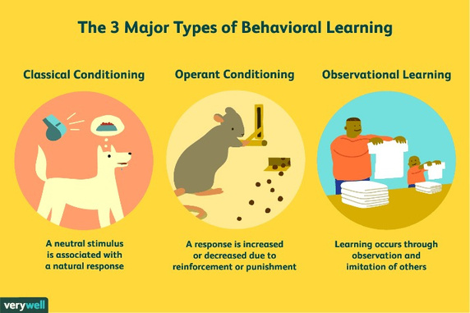
3
Learning Design Toolkit
Learning Theories
Module 1
Behaviorism
Figure1
ThreeMajor Types of Behavioral Learning.
From Three Major Types of Behavioral Learning [Graphic], by Psychology and Counselling,
2023, March 5, Facebook
Behavioral theory focuses on the way humans learn through interaction with their environment.
Behaviorism solidifies the fact that behaviors are learned through conditioning. Skinner
mentioned that conditioning is a procedure that utilizes punishment and reinforcement. The
behavioral model provides an organized approach to teaching, allowing educators to set clear
expectations and provide consistent routines. Behavioral theorists believe there is a certain way
to do tasks to cultivate a desired outcome, and the teacher determines what that looks like
(Samoila et al., 2023).
Example
This theory can be applied to student behavior plans. Many students thrive with positive They can better interact in school when their positive behaviors are rewarded (Bright, 2023). For example, if a young student struggles with speaking out inappropriately in class, they may have a positive behavior plan to encourage them when they appropriately follow classroom
© AMERICAN COLLEGE OF EDUCATION

Slide 5
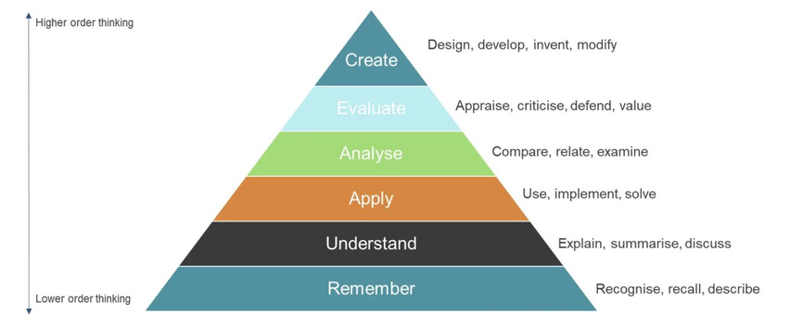
4
expectations. The plan could state that when the student does the desired task of raising their hand before asking questions, the teacher will thank them for raising their hand and waiting to be called on before speaking.
Reference(s)
Bright, K. (2023, September 21). Behaviorism in education: How to foster learning
environments. LearnLever. https://learnlever.com/behaviorism-in-education/
Psychology and Counselling. (2023, March 5). Three Major Types of Behavioral Learning
[Graphic]. Facebook. https://www.facebook.com/psychandcounselling?__tn__=-UC*F
Samoila, C., Ursutiu, D., & Munteanu, F. (2023). The remote experiment in the light of the
learning theories. International Journal of Online & Biomedical Engineering, 19(14), 26–
44. https://doi.org/10.3991/ijoe.v19i14.43163
Cognitivism
Figure 2
Bloom’s Taxonomy
Amphigean. (2020, September 1). Learning theories – cognitivism[Diagram]. Amphigean. https://amphigean.com/2020/09/01/learning-theories-cognitivism/
Cognitivism represented a shift from focusing on the behaviors oflearners to the thinking processes of learners. In cognitive psychology, the difference between behaviorism and cognitivism is described as the step that happens, and can be studied, between a person experiencing a stimulus and the behavior response (McLeod, 2015).
© AMERICAN COLLEGE OF EDUCATION

Slide 6
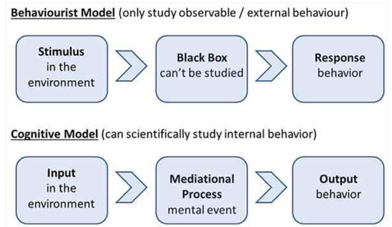
5
Figure 3 Behaviorist Model Versus Cognitive Model
.From Behaviorism, cognitivism, constructivism: Comparing critical features from an instructional design perspective, by P. A. Ertmer & T. J. Newby, 2013, Performance Improvement Quarterly, 26(2), 43–71 (https://doi.org/10.1002/piq.21143). Copyright 2013 by Wiley Periodicals, Inc.
For instructional design, this means that instead of creating materials and processes intended to
instill desired behaviors in learners, instruction is designed to foster thinking processes through
interaction with the material (Etmer, 2013).
Example
Cognitive learning can be seen during training opportunities when volunteers are asked to role- play common scenarios they may encounter in their roles. This encourages volunteers to apply what they have been learning to real-world situations. It also requires them to think critically about instruction and determine how to apply concepts within the context of the mock scenario they are presented with. Role-play opportunities are followed up with feedback to help reinforce best practices and correct misunderstandings or confusion that may exist.
Reference(s)
Amphigean. (2020, September 1). Learning theories – cognitivism [Diagram of Bloom’s
Taxonomy]. Amphigean. https://amphigean.com/2020/09/01/learning-theories- cognitivism/
Ertmer, P. A., & Newby, T. J. (2013). Behaviorism, cognitivism, constructivism: Comparing
critical features from an instructional design perspective. Performance Improvement
Quarterly, 26(2), 43–71. https://doi.org/10.1002/piq.21143
McLeod, S. A. (2015). Cognitive psychology. Simply Psychology.
https://www.simplypsychology.org/cognitive.html
© AMERICAN COLLEGE OF EDUCATION

Slide 7
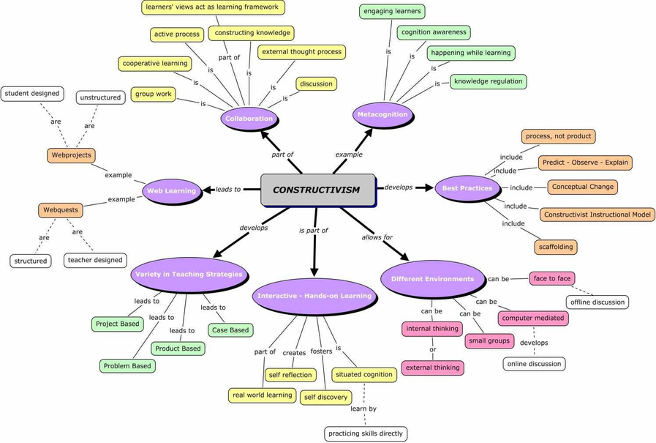
6
Constructivism
Figure 4 Constructivism Learning Theory
From Embracing the learning theory: Constructivism [Diagram], by Structural Learning, n.d., Structural Learning (https://www.structural-learning.com/post/embracing-the-learning-theory- constructivism). Copyright n.d. by Structural Learning.
Constructivist learning theory is based on the idea thatindividuals “construct knowledge as they reflect on and interpret their own experiences” (Allen,p.1). Among the most famous constructivist researchers, there are internal and externalvariables that influence how a person interprets their experiences.
© AMERICAN COLLEGE OF EDUCATION

Slide 8
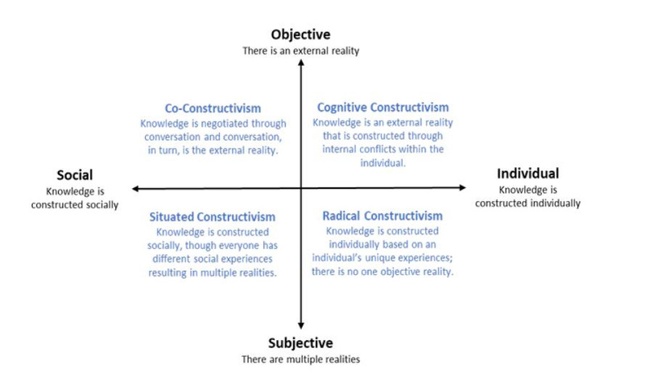
7
Figure 5 Constructivism Dimensions and Positions
From An introduction to constructivism: Its theoretical roots and impact on contemporary education, by A. Allen, 2022, Journal of Learning Design and Leadership, 1(1), 1–25 (https://ldljournal.web.illinois.edu/wp-content/uploads/2022/09/Andrew-Allen- Constructivism_JLDL_Vol1Issue1September2022.pdf). Copyright 2022 by Andrew Allen.
Since constructivism is based on individual interpretation, it is possible that an individual’s constructed knowledge is not based on reality. “Learning then becomes a matter of changes” as the connections that learners have are dynamic and interpretations can be fluid, and different people, even those with the same experience, may interpret it differently (Duffy, 1996, pp 9). Constructivism requires active engagement by learners who reflect upon their experiences, both past and present, to develop understanding and foster learning.
Example
In adult education, the constructivism learning model considers prior knowledge of learners. In a training session about best practices in fundraising strategies, a constructivism approach might be to have a group discussion where learners share their fundraising experiences and stories. Afterwards, a facilitator guides the group through reflective questions about what can be learned from the stories of others. Through social constructivism, individuals create learning through connection with others whose experiences are likely different than their own.
© AMERICAN COLLEGE OF EDUCATION

Slide 9
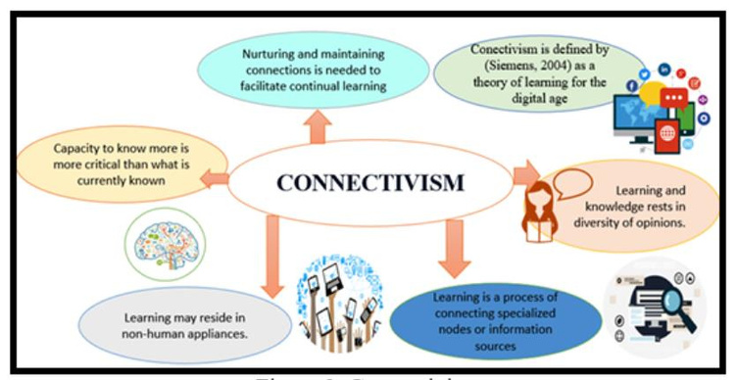
8
Reference(s)
Allen, A. (2022). An introduction to constructivism: Its theoretical roots and impact on
contemporary education. Journal of Learning Design and Leadership, 1(1), 1–25. https://ldljournal.web.illinois.edu/wp-content/uploads/2022/09/Andrew-Allen- Constructivism_JLDL_Vol1Issue1September2022.pdf
Duffy, T. M., & Cunningham, D. J. (1996). Constructivism: Implications for the design and
delivery of instruction. In D. H. Jonassen (Ed.), Handbook of Research for
Educational Communications and Technology (pp. 170–198).
http://members.aect.org/edtech/ed1/41/41-01.htmlchrome-
extension://efaidnbmnnnibpcajpcglclefindmkaj/https://people.potsdam.edu/betrusak/
621/Duffy%20and%20Cunningham%20(1996)-constructivism.pdf
Jonassen, D. H. (1991). Objectivism versus constructivism: Do we need a new
philosophical paradigm? Educational Technology Research and Development,
39(3), 5–14. https://doi.org/10.1007/BF02296434
Structural Learning. (n.d.). Embracing the learning theory: Constructivism [Diagram]. Structural
Learning. https://www.structural-learning.com/post/embracing-the-learning-theory-
constructivism
Connectivism
Figure 6
Connectivism in Cognitive Cities
From Connectivism and learning in cognitive cities, by J. Smith & A. Lee, 2020, in Proceedings of The IAFOR International Conference on Education – Hawaii 2020 (pp. 100–110)
© AMERICAN COLLEGE OF EDUCATION

Slide 10
9
(https://papers.iafor.org/wp-content/uploads/papers/iicehawaii2020/IICEHawaii2020_51679.pdf). Copyright 2020 by The International Academic Forum.
Connectivism was developed as technology became a more prevalent and influential factor in learning and development (Seimens, 2005). As technology advanced and rewrote how society functions, there were also important trends observed in learning (Siemens, 2005):
▪
Many learners will move into a variety of different, possibly unrelated fields over the
course of their lifetime.
▪
Informal learning is a significant aspect of our learning experience. Formal education
no longer comprises the majority of our learning. Learning now occurs in a variety of
ways – through communities of practice, personal networks, and through completion of
work-related tasks.
▪
Learning is a continual process, lasting for a lifetime. Learning and work related
activities are no longer separate. In many situations, they are the same.
▪
Technology is altering (rewiring) our brains. The tools we use define and shape our
thinking.
▪
The organization and the individual are both learning organisms. Increased attention to
knowledge management highlights the need for a theory that attempts to explain the link
between individual and organizational learning.
▪
Many of the processes previously handled by learning theories (especially in cognitive
information processing) can now be off-loaded to, or supported by, technology.
▪
Know-how and know-what is being supplemented with know-where (the understanding
of where to find knowledge needed)
(Siemens, 2005).
To address these notable shifts in learning, connectivism theorizes “that knowledge is
distributed across a network of connections” rather than being constructed, transferred, created,
or built as others have theorized (Downes, 2007, pp 1). Siemens (2005) defines learning as
“actionable knowledge” and postulates that it can exist outside a person in databases and that
learning how to access that knowledge is more important than knowing that information. The
implications of connectionism on instructional design are that instruction should focus on
ensuring learners know what information is available and how to access it.
Example
In nonprofit organizations, connectionism is seen through mentorships as new volunteers are connected with seasoned volunteers who can share their knowledge and answer concerns or questions. National nonprofit organizations also utilize digital chat spaces to facilitate communication among staff across the country who share the same role within their region, allowing them to discuss concerns and seek help with problem-solving, among other purposes. It is also seen in training modules that focus on acclimating new staff and volunteers to available
© AMERICAN COLLEGE OF EDUCATION

Slide 11
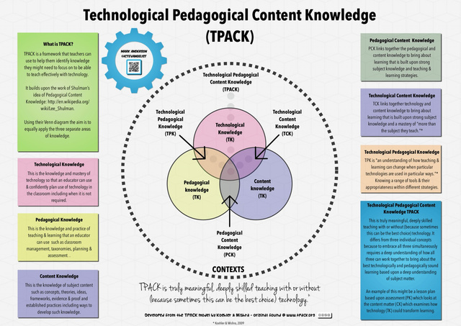
10
platforms and databases that are meant to be used to find and/or share information through the organization’s established connections.
Reference(s)
Downes, S. (2007). What connectivism is. Half an Hour. https://www.downes.ca/post/38653
Dunaway, K. M. (2011). Connectivism: Learning theory and pedagogical practice for
networked information landscapes. Reference Services Review, 39(4), 675–685.
https://doi.org/10.1108/00907321111186686
Goldie, J. G. S. (2016). Connectivism: A knowledge learning theory for the digital age? Medical
Teacher, 38(10), 1064–1069. https://doi.org/10.3109/0142159X.2016.1173661
Siemens, G. (2005). Connectivism: A learning theory for the digital age. International
Journal of Instructional Technology and Distance Learning, 2(1), 3–10.
http://www.itdl.org/Journal/Jan_05/article01.htm
Smith, J., & Lee, A. (2020). Connectivism and learning in cognitive cities. In Proceedings of The
IAFOR International Conference on Education – Hawaii 2020 (pp. 100–110). The
International Academic Forum. https://papers.iafor.org/wp-
content/uploads/papers/iicehawaii2020/IICEHawaii2020_51679.pdf
Pedagogy vs. Andragogy
TPACK|Technological Pedagogical Content Knowledge
Figure 7
TPACK
© AMERICAN COLLEGE OF EDUCATION

Slide 12
11
From TPACK explained [Diagram], by M. Anderson, n.d., ICT Evangelist (https://ictevangelist.com). Copyright n.d. by Mark Anderson.
TPACK is the knowledge that educators need to integrate technology into instructional design effectively. Koehler (2009) suggests three important elements that are central to technology use in learning:
▪
▪
Content Knowledge – an educator’s knowledge of the content to be taught Pedagogical Knowledge – an educator's knowledge of the theories, methods,
practices, and processes that support learning.
▪
Technology Knowledge – an educator’s knowledge and ability to leverage technology
to support learning.
TPACK involves not only being fluent in each of these three components but also
understanding how they relate, in order to integrate them seamlessly in instructional design
(Koehler, 2009).
Example(s)
▪
Technological Pedagogical knowledge (TPK) – As part of a virtual training
presentation, the facilitator includes interactive opportunities to think critically about
scenarios, such as “think-pair-share” to encourage collaborative learning.
▪
Technological Content Knowledge (TCK) – As part of a training, the facilitator allows
the learners to work through interactive case studies in a “choose-your-own-adventure”
format.
▪
Pedagogical Content Knowledge (PCK) – A trainer coaches best practices for
addressing common questions and concerns, like setting boundaries and protecting self-
wellness by reviewing “Common Concern” topics through interactive reflection and
guided discussions.
▪
TPACK Integration – The facilitator presents on impact measurement and the
importance of event reporting using the above suggestions and others, and then has
learners practice completing a report in the system with a realistic context from previous
engagement during the training.
Reference(s)
Anderson, M. (n.d.). TPACK explained [Diagram]. ICT Evangelist. https://ictevangelist.com Harris, J., Mishra, P., & Koehler, M. J. (2009). Teachers' technological pedagogical content
knowledge and learning activity types: Curriculum-based technology integration
reframed. Journal of Research on Technology in Education, 41(4), 393–416.
https://doi.org/10.1080/15391523.2009.10782536
Koehler, M. J., & Mishra, P. (2009). What is technological pedagogical content knowledge
(TPACK)? Contemporary Issues in Technology and Teacher Education, 9(1), 60–70.
https://citejournal.org/volume-9/issue-1-09/general/what-is-technological-
pedagogicalcontent-knowledge/
© AMERICAN COLLEGE OF EDUCATION

Slide 13
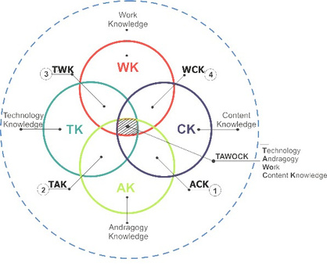
12
Mishra, P., & Koehler, M. J. (2006). Technological pedagogical content knowledge: A framework
for teacher knowledge. Teachers College Record, 108(6), 1017–1054. https://doi.org/10.1111/j.1467-9620.2006.00684.x
Voogt, J., Fisser, P., Pareja Roblin, N., Tondeur, J., & van Braak, J. (2013). Technological
pedagogical content knowledge—A review of the literature. Journal of Computer
Assisted Learning, 29(2), 109–121. https://doi.org/10.1111/j.1365-2729.2012.00487.x
TAWOK | Technology Andragogy Work Content Knowledge
Figure 8
TAWOCK Model Framework
From TAWOCK model framework on TVET [Diagram], by M. Nurtanto, 2020, ResearchGate (https://www.researchgate.net/figure/TAWOCK-Model-Framework-on-TVET_fig3_343685517). Copyright 2020 by Muhammad Nurtanto.
TAWOCK is an adaptation of TPACK model that can be applied in technical and vocational
education and training.
• Technology Knowledge (T) – Using technology as an effective tool to support learning
• Andragogy (A) – The theory of adult learning
• Work (WO) – The application of learning into relevant work
• Content Knowledge (CK) – Mastery of the subject matter
Arfin (2020) points out that a shortcoming of the TPACK model is the lack of “freedom of
students to develop mature and independently.” Therefore, in vocational learning, three
components are needed:
• Pedagogy – the engagement in learning through pedagogical approaches
• Andragogy – the cultivation and development of competency
© AMERICAN COLLEGE OF EDUCATION

Slide 14
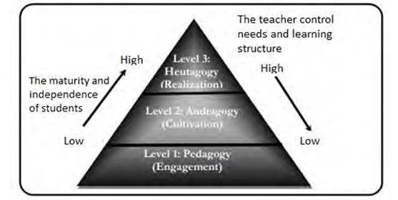
13
•Heutagogy – the realization of student maturity
Figure 9 Vocational Learning Components
From The technology andragogy work content knowledge model framework on technical and vocational education and training, by Z. Arifin, M. Nurtanto, N. Kholifah, S. Nurhaji, & W. Warju, 2020, Journal of Education and Learning (EduLearn), 14(3), 442–448 (https://files.eric.ed.gov/fulltext/EJ1266419.pdf). Copyright 2020 by Zainal Arifin et al.
Examples
▪
TAWOCK Integration – Ensuring volunteers who want to host resource tables are
trained effectively.
▪
Technology (T) – Training volunteers on how to navigate the volunteer signup
platform so they know how to use the technology to sign up for resource tabling events.
▪
Andragogy (A) – Prioritizing a learner-centered approach that values the experiences
and knowledge of adults who come to volunteer, such as discussions on what draws them to pick up resources at a resource event or what makes them skip a resource table.
▪
Work (WO) – Teaching volunteers not just how to set up a resource, as well as ways
to engage with people who stop by to pick up resources (i.e., how to greet them and
start a conversation) with practice that they can use in real life.
▪
Content Knowledge (CK) – Making sure that volunteers know the mission of the
organization, its core values, and how volunteers help the organization meet its strategic
goals and mission, which will guide them in their interactions and the way they present
the organization.
Reference(s)
Alqahtani, R. N., & Almassaad, A. Z. (2024). The impact of a training program based on the
TAWOCK model for teaching computational thinking skills on improving teaching
© AMERICAN COLLEGE OF EDUCATION

Slide 15
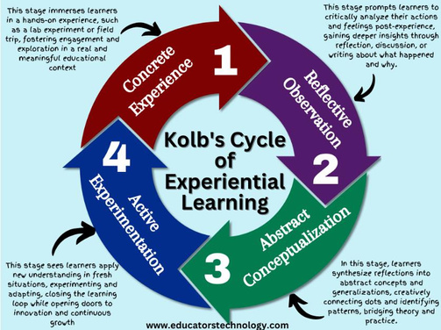
14
practices among computer teachers. Pakistan Journal of Life and Social Sciences, 22(1). https://www.pjlss.edu.pk/pdf_files/2024_1/2833-2854.pdf
Arifin, Z., Nurtanto, M., Kholifah, N., Nurhaji, S., & Warju, W. (2020). The technology andragogy
work content knowledge model framework on technical and vocational education and
training. Journal of Education and Learning (EduLearn), 14(3), 442–448.
https://files.eric.ed.gov/fulltext/EJ1266419.pdf
Nurtanto, M. (2020). TAWOCK model framework on TVET [Diagram]. ResearchGate.
https://www.researchgate.net/figure/TAWOCK-Model-Framework-on-
TVET_fig3_343685517
Learning Process Models
Kolb’s Experiential Learning Theory
Figure 10
Kolb’s Cycle of Experiential Learning
From Kolb’s cycle of experiential learning, by M. Kharbach, 2025, April 28, in Experiential learning simply explained, Educator’s Technology (https://www.educatorstechnology.com/2023/08/experiential-learning.html). Copyright 2025 by Med Kharbach. Used under fair use for educational purposes.
Experiential Learning theorizes that learning happens through four types of real-life experience:
Concrete experience, reflective experience, abstract experience, and active experimentation.
Essentially, an individual learns by “experiencing, reflecting, thinking, and acting” (Kolb, 2005).
Since participation is a requirement for real-life experience in learning, “workplaces need to
provide active support and include learners in workplace activities” (Yardley, 2012).
© AMERICAN COLLEGE OF EDUCATION

Slide 16

15
Example
If volunteers want to facilitate educational programing and give public presentations, then trainers can coordinate opportunities for volunteers to co-present with a seasoned presenter, because having that experience will allow the volunteer to gain greater understanding for how to phrase and pace the things they want to say and how to assess and adjust to their audience effectively.
Reference(s)
Educators Technology. (2023, August). Experiential learning [Diagram of Kolb’s Cycle of
Experiential Learning]. Educators Technology. https://www.educatorstechnology.com/2023/08/experiential-learning.html
Kharbach, M. (2025, April 28). Experiential learning simply explained. Educator’s Technology.
https://www.educatorstechnology.com/2023/08/experiential-learning.html
Kolb, A. Y., & Kolb, D. A. (2005). Learning styles and learning spaces: Enhancing experiential
learning in higher education. Academy of Management Learning & Education, 4(2), 193–
212. https://doi.org/10.5465/amle.2005.17268566
Yardley, S., Teunissen, P. W., & Dornan, T. (2012). Experiential learning: Transforming theory
into practice. Medical Teacher, 34(2), 161–164.
https://doi.org/10.3109/0142159X.2012.643264
Gagne’s Nine Events of Instruction
Figure 11
Gagné’s Nine Events in Workplace Training
From Gagné’s nine events in workplace training [Infographic], by D. Gupta, 2024, December 17, Whatfix (https://whatfix.com/blog/gagnes-nine-events-of-instruction-model/). Copyright 2024 by Whatfix.
© AMERICAN COLLEGE OF EDUCATION

Slide 17
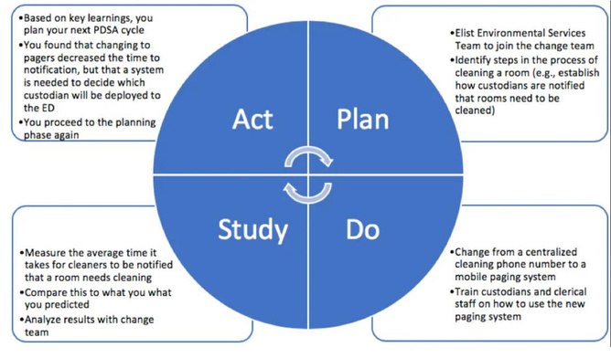
16
Gagne theorized that learning needs to be broken into smaller chunks to allow for maximum retention and minimize mental load. This does not mean that a long lecture or lesson should be presented in short parts, but rather that learning should be broken into more easily digestible parts, each with its own objective and specific outcomes, and each following Gagne’s prescribed nine steps (McNeill, 2023).
Example
To follow Gagne’s theory, an hour presentation on Volunteer 101 can be broken down into
individual parts, such as: Who are we? What do we do? Why do we do what we do? How can
you get involved? Each of those chunked lessons would follow Gagne’s nine steps. Ideally, as
part of the instruction, learners will find out how to re-read, re-watch, or re-try aspects of the
training as much as they want and whenever they want.
Reference(s)
Goodwin, L. D. (1999). Gagné’s theory of instruction: Contributions to the design of teaching.
The Educational Forum, 63(4), 372–379. https://doi.org/10.1080/00131729908984445
Gupta, D. (2024, December 17). Gagné’s nine events in workplace training [Infographic].
Whatfix. https://whatfix.com/blog/gagnes-nine-events-of-instruction-model/
McNeill, L., & Fitch, D. (2023). Microlearning through the lens of Gagne’s nine events of
instruction: A qualitative study. TechTrends: Linking Research and Practice to Improve
Learning, 67(3), 220–230. https://research.ebsco.com/linkprocessor/plink?id=eb3197f7-
fdda-3880-be2a-342332fe34f6
PDSA Cycle | Plan Do Study Act Cycle
Figure 12
Plan-Do-Study-Act (PDSA) Cycle.
Adapted from Which strategy to choose: PDSA, Lean, or Six Sigma? [Figure of Plan Do Study Act cycle], 2019, CanadiEM (https://canadiem.org/which-strategy-to-choose-pdsa-lean-or-six- sigma/). Licensed under CC BY-NC-SA 4.0.
© AMERICAN COLLEGE OF EDUCATION

Slide 18
17
This theory is a cycle that provides “a structure for iterative testing of changes to improve the quality of the system” (Taylor, 2014). In essence, it is meant to guide organizations through the thoughtful implementation of a plan for change to create improvement, followed by a period of outcome evaluation and tweaks before beginning the cycle again by implementing the updated plan.
Example
In the nonprofit world, it is common to hear, “Let’s try it and see what happens, and then we’ll
know if it’s a good idea or not.” Often, this comes about in planning fundraising initiatives or
events. When applied to developing staff, this framework would allow new staff to try their ideas
in a well-structured way to see if they work and then adjust. This is a fundamental method to
use when an organization wants to keep fresh staff feeling passionate and motivated to try new
things with great energy.
Reference(s)
CanadiEM. (2019, January 4). Which strategy to choose: PDSA, Lean, or Six Sigma? [Figure of
Plan-Do-Study-Act cycle]. CanadiEM. https://canadiem.org/which-strategy-to-choose- pdsa-lean-or-six-sigma/. Licensed under CC BY-NC-SA 4.0
Reed, J. E., & Card, A. J. (2016). The problem with Plan-Do-Study-Act cycles. BMJ Quality &
Safety, 25(3), 147–152. https://doi.org/10.1136/bmjqs-2015-005076
Taylor, M. J., McNicholas, C., Nicolay, C., Darzi, A., Bell, D., & Reed, J. E. (2014). Systematic
review of the application of the plan–do–study–act method to improve quality in
healthcare. BMJ Quality & Safety, 23(4), 290–298. https://doi.org/10.1136/bmjqs-2013-
001862
© AMERICAN COLLEGE OF EDUCATION

Slide 19

18
Design Models
Module 2
Instructional Design (ID) vs. Learning Experience Design (LXD)
Instructional Design (ID) and Learning Experience Design (LXD) define an approach to creating a learning experience. Design includes understanding the audience's needs and goals to create learning activities and effective content delivery. The two methods are complementary and do not have to exist exclusively. ID emphasizes learning and supports a step-by-step process for developing instruction. Typically, instruction is driven by learning objectives, direct instruction, and uses traditional assessments to evaluate learning. LXD has an integrated approach with a heavier emphasis on emotional, social, and cognitive aspects of learning. In LXD, the focus is on integrating hands-on and collaborative instruction that often utilizes technology. According to Floor (2023), “A great way to explain the general difference between LXD and ID is by comparing a scientist to an artist” (para. 2). Like a scientist, the instructional designer follows a methodical process with clear objectives and measurable results. Meanwhile, the learning experience designer, like an artist, creates engaging, emotionally rich experiences that connect with learners on multiple levels beyond just transferring information.
Example
An example demonstrating the difference between ID and LXD can be illustrated in a
professional development session with school staff. The staff will receive training on the new
Assessment Feature in the school’s LMS.
Instructional Design (ID)
Learning Experience Design (LXD)
The staff is presented with the learning objective to learn the new online feature. Staff are required to use online assessments to collect data. 
The instructor demonstrates the skills and
steps to complete the goals.  The staff members try the step-by-step implementation as guided by the instructor. 
Staff have begun using the new online
feature in their classrooms. Instructors and
administration evaluate and hold staff
The staff is presented with a problem that needs to be solved. The administration needs a way to collect data as students complete formative work. The staff are given the new online assessment feature on the LMS as a possible option.
✵
Thestaff begins to explore the LMS and its
features to experiment with how it works and
whatit can do. As they explore, they create
listsof pros and cons. The staff notes items
forwhich they need further training or
exploration.
✵
© AMERICAN COLLEGE OF EDUCATION

Slide 20

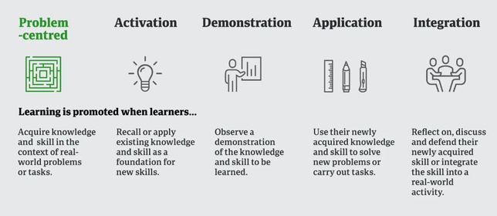
19
accountable for carrying out the directive.
Through collaboration, the staff determines that the online LMS is the best way to collect data. The staff begins using the assessment feature to collect data.  As the data are collected, the administration and staff evaluate the effectiveness and
adjust accordingly.
Reference(s)
Floor, N. (2023, November 9). Learning experience design vs instructional design. Learning
Experience Design. https://lxd.org/news/learning-experience-design-vs-instructional-
design/
First Principles of Instruction
Merrill’s Principles of Instruction
Figure 13
Merrill’s First Principles of Instruction.
Adapted from First Principles of Instruction, by M. D. Merrill, 2012, Pfeiffer. Copyright 2012 by John Wiley & Sons.
David Merrill, an educational researcher, studied some of the most well-known instructional
theories and models to identify their shared characteristics. His goal was to create a list of
common principles that would provide a more universal model for instructional design. This list
of principles is Merrill’s First Principles of Instruction (Merrill, 2002). Merrill (2009) identified the
following principles as the First Principles of Instructional Design:
1. Demonstration: Learning is promoted when learners observe a demonstration.
2. Application: Learning is promoted when learners apply the new knowledge.
3. Task-centered: Learning is promoted when learners engage in a task-centered
instructional strategy.
© AMERICAN COLLEGE OF EDUCATION

Slide 21
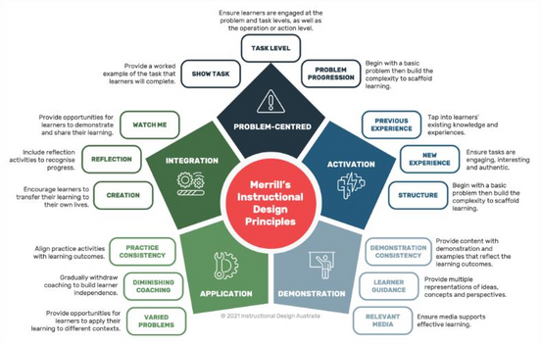
20
4. Activation: Learning is promoted when learners activate relevant prior knowledge or experience. 5. Integration: Learning is promoted when learners integrate their new knowledge into their everyday world. (Merrill, 2009, p. 4-5)
Figure 14 Infographic summary of Merrill’s instructional design principles.
Adapted from Infographic Summary of Merrill’s Instructional Design Principles, by Discover Learning, 2021 (https://discoverlearning.com.au/2021/06/how-to-apply-merrills-instructional- design-principles/). Copyright 2021 by Discover Learning. Used under fair use for educational purposes.
Example
Merril’s First Principles of Instruction could be used to train volunteers on how to respond to
challenging scenarios when presenting in front of an audience.
1. Problem/Task: Present the problem by sharing real-world scenarios of challenging
situations that have happened during presentations.
2. Activation: Invite discussion about commonalities volunteers have witnessed in great
de-escalation scenarios versus commonalities they have witnessed in bad de-escalation
attempts.
3. Demonstration: Invite volunteers to try and challenge the trainer with various
situations or scenarios to see how they respond to challenging situations. Offer an
example challenge situation to get volunteers thinking.
4. Application: Reverse the roles of the trainer and volunteers to practice responding
appropriately to challenging situations. The trainer can offer tips, corrections,
clarifications, and other guidance as needed (especially at first), until volunteers
consistently respond to challenge scenarios appropriately. Afterward, ask volunteers to
independently evaluate case study situations to determine what went right and what
went wrong in the interaction. If the interaction went wrong, ask the volunteer to provide
© AMERICAN COLLEGE OF EDUCATION

Slide 22
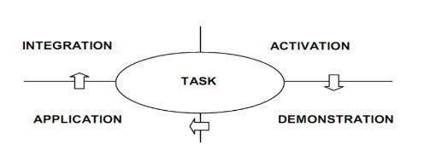
21
instructions for the case study presenter about how they can improve their approach moving forward. 5. Integration: Once the volunteer demonstrates successful understanding of how to respond to challenging situations, they will have the opportunity to put this into practice during real-life presentations with a mentor present to help navigate challenging situations that arise if they struggle, until they demonstrate mastery of this skill.
Reference(s)
Clark, R. C. (2003). Building Expertise: Cognitive Methods for Training and Performance
Improvement . Washington D.C., International Society for Performance Improvement.
Merrill, M. D. (2002). First Principles of Instruction. Educational Technology Research and
Development. 50(3), 43-59. https://mdavidmerrill.wordpress.com/wp-
content/uploads/2019/04/firstprinciplesbymerrill.pdf
Merrill, M. D. (2007). A task-centered instructional strategy. Journal of Research on Technology
in Education, 40(1), 33-50. https://mdavidmerrill.wordpress.com/wp-
content/uploads/2019/04/task_centered_strategy_published.pdf
Merrill, M. D. (2009). First Principles of Instruction. In C. M. Reigeluth & A. Carr
(Eds.), Instructional Design Theories and Models: Building a Common Knowledge Base
(Vol. III). New York: Routledge Publishers. https://mdavidmerrill.wordpress.com/wp-
content/uploads/2019/07/firstprinciplesreigeluthcarr-1.pdf
Truong, M. T., Elen, J., & Clarebout, G. (2019, May). Implementing Merrill's first principles of
instruction: Practice and identification. Journal of Educational & Instructional Studies in
the World, 9(2), 25–34.’ https://research.ebsco.com/c/36ffkw/viewer/pdf/gk5s5joaln
Merrill’s Four-Phase Cycle of Instruction
Figure 15
The four-phase cycle of instruction.
From Identifying Merrill’s First Principles of Instruction in a BlendedLearning Course in Hanoi University, Vietnam [Master’s thesis], by T. T. M. Truong, 2012, Katholieke Universiteit Leuven, Faculty of Psychology and Educational Sciences. Copyright 2012 by Truong Thi My.
© AMERICAN COLLEGE OF EDUCATION

Slide 23
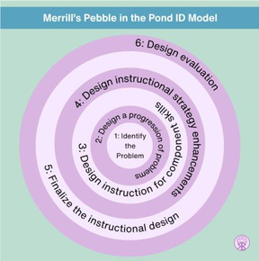
22
This four-phase cycle is a framework for implementing the First Principles of Instruction within a learning environment. Within this framework, an overarching problem is introduced to learners, who then learn how to address it through a series of instructional tasks. Each task follows the four-phase learning cycle. Learners repeat this cycle for each task. When all tasks are completed, the learner should have the necessary knowledge and skills to achieve the learning goal(s) (Merrill, 2007).
To design a four-phase learning experience, Merrill suggests a “pebble-in-the-pond” approach.
Figure 16 Merrill’spebble-in-the-pond model.
From A pebble-in-the-pond model for instructional design, by M. D. Merrill, 2002, Performance Improvement, 41(7), pp. 39–44 (reprinted 2015, Performance Improvement, 54(5), pp. 40–45). Copyright 2002 by David D. Merrill. Adapted with permission.
Merrill (2007) elaborates on each ripple of the pond as follows:
Ripple 1: Identify a real-world problem or a whole task that learners could encounter. A problem
or a whole task includes the following parts:
1. Inputs – the defined “givens” or information about the problem/task.
2. A goal – the identified overarching outcome (i.e., the product, activity, etc.) that
learners are working to produce.
3. A solution – the specific task(s) (see ripple 2) that transforms the givens into the
desired goal.
(Merrill, 2007)
Figure 17 Asampleproblem with identified tasks.
© AMERICAN COLLEGE OF EDUCATION

Slide 24
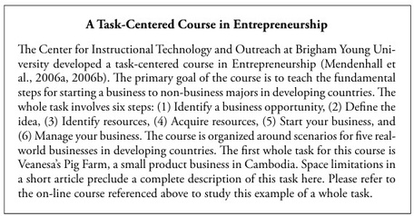
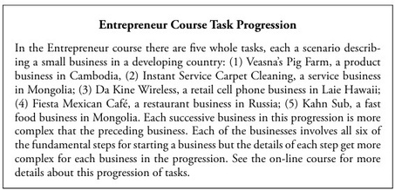
23
Ripple 2: Identify the task(s) learners need to complete to produce the desired goal. (i.e. the six fundamental steps of starting a business in Figure 17)
1. Determine specific task(s) that are complete in and of themselves, not just steps in a
larger task, that need to be completed to produce the desired goal.
a. Identify the steps (subtasks) that learners need to take to complete each task.
2. In a progression of tasks, sequence tasks so each is more complex than the previous.
3. Adjust tasks as needed to ensure each task:
a. progresses smoothly to the next and
b. can be effectively demonstrated and applied.
(Merrill, 2007)
Figure 18 Asampleof task progression.
Ripple 3: Identify the content components of each task, taking into consideration the task’s steps.
1. Determine the content components needed for each task:
a. Information – knowledge learners need to have or gain to complete a task.
b. Portrayal(s) – real-world example(s) of the information as it applies to the task.
2. Determine or develop knowledge object(s) – the framework(s) for how learners will
organize and store a task’s content components.
3. Define the learning outcome(s) for each task:
© AMERICAN COLLEGE OF EDUCATION

Slide 25
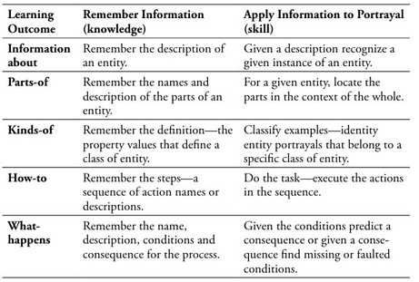
24
a. Knowledge learning outcome(s) – the desired information the learner will retain after completing the task. b. Skill learning outcome(s) – the desired ability the learner will have to apply their knowledge to real-world scenarios after completing the task.
4. Assign one of the four knowledge analysis procedures to each subtask
a. presentation (tell), b. demonstration (show), c. recall (ask), and d. apply (do)
(Merrill, 2007)
The four knowledge analysis procedures resemble Bloom’s Taxonomy, and they function in a
similar manner, with 'tell/show' representing lower-order thinking and ‘recall/do/ represent
higher-order thinking. Earlier tasks will use lower-order thinking procedures. As learners
progress through the tasks, the knowledge analysis procedure will transition to higher-order
thinking processes. The final task will prioritize higher-level thinking procedures.
Figure 19 Thefivekinds of knowledge and skill acquired through instruction.
Ripple 4: Define the instructional strategy steps for the whole task or series of whole tasks. Follow the steps shown in Figure 20. Figure 20 Thetask-centered instructional strategy.
© AMERICAN COLLEGE OF EDUCATION

Slide 26
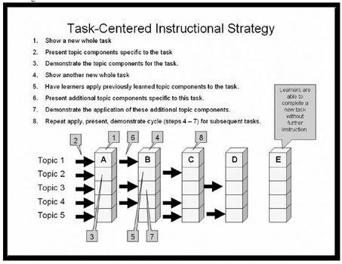
25
Example
Use Merrill’s Four-Phase Cycle (activation, demonstration, application, and integration) to instruct volunteers in each step of utilizing the volunteer signup application.
Ripple 1: Problem/Task Identification. Volunteers need to be able to confidently use the
volunteer signup platform.
1. Input: The platform’s name and purpose. The platform is how volunteers can look for
and sign up for opportunities to get involved or to post opportunities for other volunteers
to get involved with them.
2. Goal: Empowering volunteers to get involved in ways that fulfill their personal desires
and needs to give back.
3. Solution: Volunteers will learn to leverage the various components of the volunteer
platform by 1) Identifying opportunities to get involved, 2) Committing to Volunteer
Opportunities, and 3) Connecting with other volunteers.
Ripple 2: Task Progression
1. Identify Tasks and Subtasks
a. Identify opportunities to get involved
i.Access the volunteer opportunity calendar
ii.Use the calendar search and filter features
iii.Access opportunity details to learn more
b. Commit to volunteer opportunities
i.Identify available slots to help out
ii.Claim an available slot
iii.Edit commitment
c. Connect with other volunteers
i.Discover other ways to get involved
ii.Post new opportunities on the calendar
© AMERICAN COLLEGE OF EDUCATION

Slide 27
26
iii.Communicate with other volunteers who want to get involved with you
Ripple 3: Task Components. (Knowledge objects = volunteer platform checklist and case-study-
volunteer outcomes)
1. Identify opportunities to get involved. (KO = case study volunteer matching –
volunteers can successfully match case study volunteers with relevant opportunities to
get involved)
a. Information: Platform location, login, filters, search features, and color-coding
features.
b. Portrayal: Examples of why the color codes matter and how search features
help.
2. Commit to volunteer opportunities (KO = case study volunteer commitment
notifications – volunteers can sign up case-study-volunteers for relevant opportunities or
change their commitments)
a. Information: Signup requirements, reminder process, and the change process.
b. Portrayals: examples of why info matters, what happens if the process is not
followed.
3. Connect with other volunteers (KO = case-studyvolunteer submission – volunteers
can add appropriate new volunteer opportunities on the calendar)
a. Information: Search ideas, submission requirements, and confirmation
process.
b. Portrayals: Examples of why requirements matter and what happens if the
process is not followed.
Ripple 4: Instructional Strategy – Four-Phases of Instruction. Follow these phases for each of
the three tasks outlined above.
1. Activation – Connect to what volunteers know from other platforms and experiences
volunteering
2. Demonstration – Show how to complete each task using a case study volunteer.
3. Application – Have volunteers “help” 3 case study volunteers, applying appropriate
scaffolding that decreases with each case study.
4. Integration – Have volunteers apply what they learned for themselves and sign up for
their first opportunity (get involved) and share a new opportunity (connect with other
volunteers to get involved).
Reference(s)
Merrill, M. D. (2002). A pebble-in-the-pond model for instructional design.
Performance
Improvement, 41(7), 39–44. https://doi.org/10.1002/pfi.4140410709
Merrill, M. D. (2007). A task-centered instructional strategy.
JournalofResearch on Technology
in Education, 40(1), 33-50. https://mdavidmerrill.wordpress.com/wp-
content/uploads/2019/04/task_centered_strategy_published.pdf
© AMERICAN COLLEGE OF EDUCATION

Slide 28
27
Merrill, M. D. (2009). Finding e3 (effective, efficient and engaging) Instruction. Educational
Technology, 49(3), 15-26. https://mdavidmerrill.wordpress.com/wp- content/uploads/2019/04/finding_e3_instruction_edtechfinal.pdf
Merrill, M. D., & Gilbert, C. G. (2008). Effective peer interaction in a problem-centered
instructional strategy. Distance Education, 29(2), 199-207.
https://mdavidmerrill.wordpress.com/wp-content/uploads/2019/04/peerinteractive-.pdf
Truong, T. T. M. (2012). Identifying Merrill’s first principles of instruction in a blended learning
course in Hanoi University, Vietnam [Master’s thesis, Katholieke Universiteit Leuven,
Faculty of Psychology and Educational Sciences]. ResearchGate.
https://www.researchgate.net/publication/337590470_IDENTIFYING_MERRILL'S_FIRS
T_PRINCIPLES_OF_INSTRUCTION_IN_A_BLENDED_LEARNING_COURSE_IN_HAN
OI_UNIVERSITY_VIETNAM
Project Management Models
Agile
Agile emerged through a manifesto that provides a framework intended to guide software development (Beck, 2001). According to the manifesto (2001), there are twelve key principles for software development:
1. Satisfy the customer through early and continuous delivery of valuable software.
2. Welcome changing requirements at any stage in development for the customer’s
competitive advantage.
3. Deliver working software frequently (i.e., in a couple of weeks to a couple of months)
4. Businesspeople and developers must work together daily throughout the project.
5. Build projects around motivated individuals, giving them the environment and support
needed, and trust them to “get the job done.”
6. Face-to-face conversation is the most effective and efficient method of sharing
information for a development team.
7. Working software if the primary measure of success
8. Promote sustainable development where all parties in the development can maintain
a constant pace indefinitely.
9. Maintain continuous attention to technical excellence and sound design.
10. Simplicity (maximizing the amount of work not done) is essential.
11. The best software development comes from self-organized teams.
12. Teams must regularly reflect on how to become more effective and then adjust
accordingly. (Beck, 2001)
While these principles were written for software development, they also lend themselves well to
other industries, including instructional design and learning and development. Instructional
designers can “leverage Agile as a mindset” and adapt the key principles behind the method to
help “manage unpredictability and changing requirements” (Scanlon, 2001).
© AMERICAN COLLEGE OF EDUCATION

Slide 29
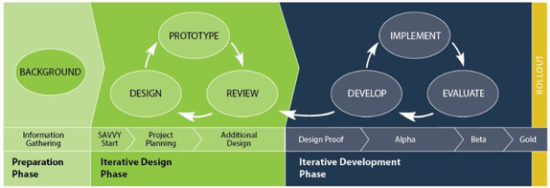
28
Example
This method can be reworked into a framework for Learning and Development solutions in the nonprofit sector. Scanlon’s (2021) reworked principles for learning and development are:
1. Satisfy the customer through early and continuous efforts to build valuable L&D
solutions.
2. Welcome changing requirements throughout the project to support the client’s
competitive advantage.
3. Deliver functional e-learning modules on the shortest possible timescale
4. Business stakeholders and the L&D team must collaborate and communicate
throughout the project
5. Build projects around a motivated team that wants to be agile. Support and trust them
to do a great job
6. Communicate as frequently as possible through face-to-face conversation
7. A working e-learning module is the primary measure of progress
8. Maintain a steady pace, indefinitely
9. Attention to sound design enhances agility
10. Simplicity is essential
11. The best e-learning solution emerges from self-organizing teams
12. Regularly reflect on how to be more effective, and then adjust accordingly
Reference(s)
Beck, K. et al. (2001). Manifesto for Agile Software Development. https://agilemanifesto.org/ Scanlon, S. (2021, July 6).
Elblearning. (2024). Embracing Agile methodologies in L&D. ELB Learning Blog. Retrieved from
https://blog.elblearning.com/embracing-agile-methodologies-in-ld
Scanlon, S. (2021, July 6). How to apply the 12 Agile principles to L&D project management.
eLearning Industry. Retrieved from https://elearningindustry.com/apply-12-agile-
principles-ld-project-management
SAM | Successive Approximation Model
Figure 21
The successive approximations model.
© AMERICAN COLLEGE OF EDUCATION

Slide 30
29
From The Successive Approximations Model [Diagram], by Allen Interactions, n.d., Allen Interactions (https://learn.alleninteractions.com/services/custom-learning/sam/elearning- development). Copyright n.d. by Allen Interactions. Used under fair use for educational purposes.
SAM is a model that “breaks eLearning development into more manageable tasks” in a cyclical
design that allows greater flexibility in addressing production issues as they arise unlike ADDIE
and other linear models (Pappas, 2024). Pappas (2024) proposes the following seven steps for
implementing SAM based on the prescribed three phases of development:
1. Involve key stakeholders in all steps of development
Preparation phase
2. Identify goals and outcomes.
3. Gather resources and research.
4. Host a brainstorming session.
Iterative Design Phase
5. Plan and prototype.
Iterative Development
6. Create a design Proof
7. Implement multiple evaluation phases
Example
SAM can be used when developing online training modules for volunteers.
1. Preparation Phase – Brainstorm and gather stakeholder and volunteer feedback.
2. Iterative Design Phase – Outline or storyboard training modules and draft volunteer
portal wireframe. Evaluate, get feedback, repeat.
3. Iterative Development Phase – Create a working design proof, engage in 3 rounds of
review/feedback.
Reference(s)
Allen, M. W., & Sites, R. (2012). Leaving ADDIE for SAM: An agile model for developing the
best learning experiences. ASTD Press.
Allen Interactions. (n.d.). The Successive Approximations Model [Diagram]. Allen Interactions.
https://learn.alleninteractions.com/services/custom-learning/sam/elearning-development
Pappas, C. (2024, August 5). 7 tips to implement the SAM model in eLearning. eLearning
Industry. Retrieved from https://elearningindustry.com/tips-implement-sam-model-in-
elearning
SAMR | Substitution, Augmentation, Modification, and Redefinition
Figure 22
SAMR Model for technology integration.
© AMERICAN COLLEGE OF EDUCATION

Slide 31
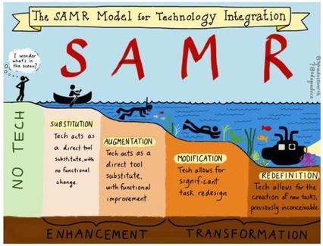
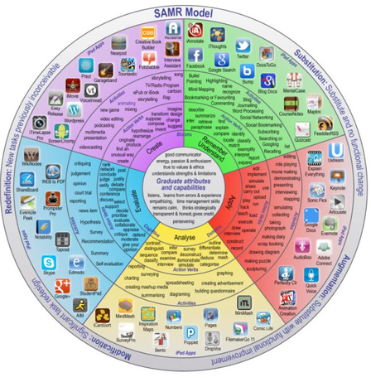
30
From SAMR Model [Diagram], by Auburn SchoolDepartment, n.d., Auburn School Department (https://www.auburnschl.edu/departments/technology_team/tech_tools_for_teachers/samr_mod el). Copyright n.d. by Auburn School Department.Used under fair use for educational purposes.
SAMR is a model that identifies the degrees to which technology can impact task- based learning. It provides a framework for how to leverage technology in instructional design that can “allow for the creation of new tasks previously inconceivable” (Puentadora, 2013).
Figure 23
Examples of SAMR in practice.
© AMERICAN COLLEGE OF EDUCATION

Slide 32
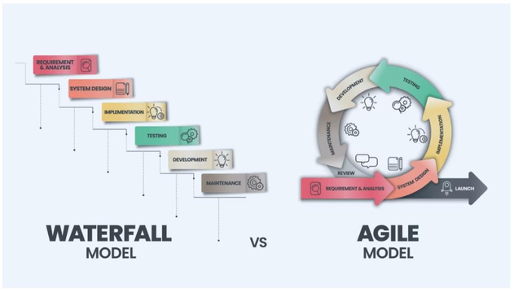
31
From SAMR Model [Diagram], by Auburn School Department, n.d., Auburn School Department (https://www.auburnschl.edu/departments/technology_team/tech_tools_for_teachers/samr_mod el). Copyright n.d. by Auburn School Department. Used under fair use for educational purposes.
Example(s)
1. Substitution – Volunteers can submit online volunteer application forms.
2. Augmentation – Volunteers can offer online event registration so attendees can
modify their registration and receive automated confirmations and updates.
3. Modification – Volunteers can collaborate in SharePoint spreadsheets for event
planning, tracking, and evaluation.
4. Redefinition - Volunteers can produce and publish their impact stories and their
“why” to help raise awareness, and to recruit additional volunteers and sponsors.
Reference(s)
Auburn School Department. (n.d.). SAMR model [Diagram]. Auburn School Department.
https://www.auburnschl.edu/departments/technology_team/tech_tools_for_teachers/sam
r_model
Puentedura, R. R. (2013). SAMR: A contextualized introduction. Retrieved from
http://www.hippasus.com/rrpweblog/
Edutopia. (2019, May 15). A powerful model for understanding good tech integration. Retrieved
from https://www.edutopia.org/article/powerful-model-understanding-good-tech-
integration/
Waterfall
Figure 24
Waterfall versus Agile.
© AMERICAN COLLEGE OF EDUCATION

Slide 33
32
From Agile vs. Waterfall [Diagram], by BairesDev, 2023, BairesDev Blog (https://www.bairesdev.com/blog/agile-vs-waterfall/). Copyright 2023 by BairesDev. Used under fair use for educational purposes.
In this model, a linear framework of steps is provided as a guide for project teams. In this
methodology, “each step is dependent on the output of the previous step” (BairesDev, 2023).
BairesDev (2023) suggests this model is a good fit for projects that:
▪
▪ ▪ ▪
do not expect changes or unexpected developments, do not prioritize customer or stakeholder feedback, do not undergo multiple levels of testing or redevelopment, and have a well-defined timeline.
(BairesDev, 2003)
Example
This model can be used during the semi-annual volunteer handbook review and redesign.
1. Analysis - What has changed, or needs updating?
2. Design – Bring up to date with current imagery and organization verbiage.
3. Develop – Make the changes and updates.
4. Implement – Distribute to volunteers.
5. Review – Begin a list of items to address in future updates.
Reference(s)
BairesDev. (2023). Agile vs. Waterfall [Diagram]. BairesDev.
https://www.bairesdev.com/blog/agile-vs-waterfall/
Kirvan, P., Lutkevich, B., & Lewis, S. (2024, November 15).
WhatistheWaterfallmodel?
Definition and guide. TechTarget. Retrieved from
https://www.techtarget.com/searchsoftwarequality/definition/waterfall-model
ADDIE | Analysis, Design, Development, Implementation, and Evaluation
Figure 25
The five phases of ADDIE.
© AMERICAN COLLEGE OF EDUCATION

Slide 34
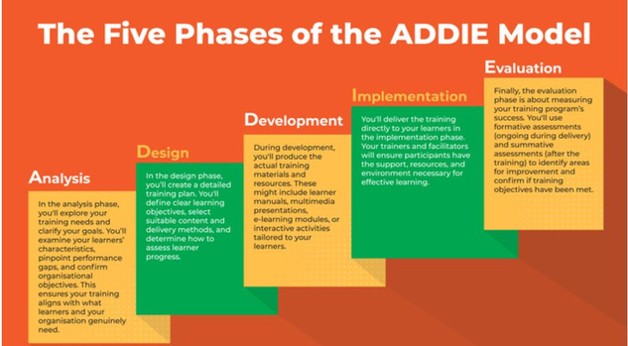
33
From RTO’s guide to using the ADDIE model for instructional design[Diagram], by RTO Learning Materials, n.d., RTO Learning Materials (https://rtolearningmaterials.com.au/blog/rtos- guide-to-addie-model/).
ADDIE is a framework comprising five phases that is widely used to guide the development and
delivery of training and education (RTO, 2025). There is no substantiated origin for this model; it
is thought to be a term used to describe a framework of instructional design based on the
acronym ADDIE (Molena, 2003). Nadiyah and Shahbodin (2025) elaborate on the five phases:
1. Analysis – Define the learning givens, needs, and preferences (i.e., environment,
design, interaction, instruction, outcomes, materials, assessment)
2. Design – Integrate the learning theories and models into the framework of the chosen
design model to meet learning objectives and outcomes.
3. Development – Develop a draft and prototype.
4. Implementation – Implement the prototype.
5. Evaluation – Obtain user feedback to guide evaluation. Repeat cycle as needed.
Example
Utilize the ADDIE model to implement community outreach education initiatives.
1. Analysis – Define goals within the framework of organizational strategic goals,
mission, and core values. Assess desired outcomes, materials, resources, connections,
partnerships, and other relevant factors.
2. Design – Integrate desired outcomes (i.e., education material distribution vs
educational classes vs trainings vs self-care support, etc.)
3. Develop – leverage the community stakeholders to develop an education initiative
4. Implement – launch initiative
5. Evaluation – solicit community and stakeholder feedback. Adjust, repeat.
Reference(s)
Molenda, M. (2003). In search of the elusive ADDIE model.
Performance Improvement, 42
(5),
34–36.
© AMERICAN COLLEGE OF EDUCATION

Slide 35
34
https://research.ebsco.com/c/36ffkw/search/details/3vfwlx3jrf?limiters=FT%3AY&q=in%2 0search%20of%20ADDIE
Moodie, A. M. (2022, July 19). Introduction to instructional design – using the ADDIE model in
workplace training. Moodle News. Retrieved from https://moodle.com/news/instructional-
design-workplace/
Nadiyah, R. S., & Shahbodin, F. (2015). The development of online project-based collaborative
learning using ADDIE model. Procedia - Social and Behavioral Sciences, 195, 1803–
1812. https://doi.org/10.1016/j.sbspro.2015.06.392
RTO Learning Materials. (2025). RTO guide to using the ADDIE model for instructional design.
Retrieved from https://rtolearningmaterials.com.au/blog/rtos-guide-to-addie-model/
© AMERICAN COLLEGE OF EDUCATION

Slide 36
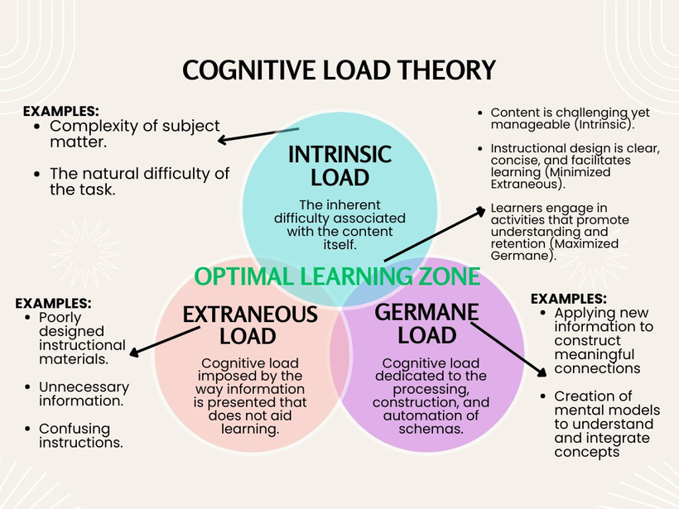
35
Cognitive Load
Module 3
Cognitive Load Theory
Cognitiveload theory provides a framework for understanding the mental processes involved in learningand the limitations of our working memory. Clark and Mayer (2024) define learning as a changeinknowledge caused by experience. Cognitive load theory builds on this by examining how ourbrains process, store, and manage information during learning. Figure 26 CognitiveLoad Theory
At its core, the theory recognizes that our working memory has limited capacity. When these limits are exceeded, learning becomes ineffective. The theory identifies three distinct types of cognitive load:
© AMERICAN COLLEGE OF EDUCATION

Slide 37
36
Intrinsic load represents the inherent complexity of the material being learned. This load varies based on the learner's prior knowledge and the complexity of the content itself. Effective instruction carefully manages this essential processing to enhance learning (Clark & Mayer, 2024).
Extraneous load is the unnecessary mental effort caused by poor instructional design. This
includes confusing layouts, irrelevant information, or unnecessarily complex explanations. As
Clark and Mayer (2024) emphasize, well-designed courses minimize extraneous processing
through thoughtful design strategies.
Germane load is the productive mental effort that contributes to deeper understanding. This
includes activities that help learners construct schemas and apply knowledge. Courses should
intentionally foster this generative processing to maximize learning and create lasting memories
(Clark & Mayer, 2024).
In simple terms, cognitive load can be understood as the total mental effort required by a
learner's brain when processing new information. Instructional designers must carefully balance
these three types of cognitive load—reducing extraneous load, managing intrinsic load, and
optimizing germane load—to create effective learning experiences.
Example
Cognitive load theory would apply during any instructional design project. If instructors were designing online professional development for training on new gradebook software at a school, they would minimize unnecessary cognitive burdens because learners have limited working memory capacity (Sweller, 2020). The designer would manage the intrinsic load by referring to what the staff currently uses for a gradebook. The course would refer to terms and names that the staff knows and break each component into smaller bits of information. The designer would minimize extraneous load by using a variety of learning experiences. The necessary content would be concise, include well-organized images, highlight important steps, and show each step necessary. Staff could easily follow the steps needed to learn the new gradebook. The training would maximize germane load by asking staff to work in groups and practice what they are learning during the training. The professional development would include scenarios asking the staff to solve problems using the new gradebook.
Reference(s)
Clark, R. C., & Mayer, R. E. (2024).
E-learningand thescienceofinstruction:Provenguidelines
forconsumersanddesignersofmultimedia learning
. John Wiley & Sons, Inc.
Sweller, J. (2020). Cognitive load theory and educational technology.
EducationalTechnology
Research and Development, 68(1), 116.
Managing Cognitive Load
Multimedia Principle
Figure 26 Mayer’sPrinciples: Using multimedia for e-learning.
© AMERICAN COLLEGE OF EDUCATION

Slide 38
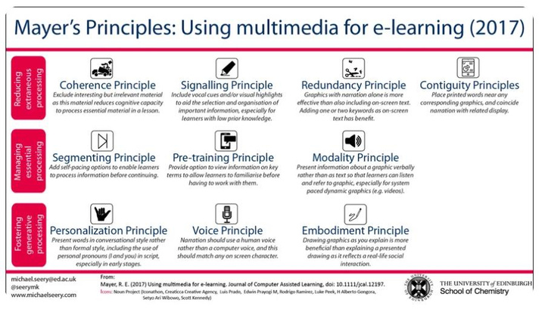
37
From Using multimedia for e-learning: Scientific support for the split-attention principle, byB. Meyer, 2017, Journal of Computer Assisted Learning, 33(6), p. 557. https://doi.org/10.1111/jcal.12165. Copyright © 2017 The Authors. Published by John Wiley& Sons Ltd.
Cognitive theory of multimedia learning (CTML) is a “continuing and evolving attempt to
understand how meaningful learning works” (Mayer, 2024). Multimedia is the use of verbal and
visual components together to present information (Richter et al., 2016). Mayer(2005) proposed
three key assumptions in multimedia learning, which Akçayir et al (2012) elaborate:
1. Dual-channel – Information can be presented and learned through two key channels:
visually and auditorily.
2. Limited Capacity – Each channel has limited capacity for processing at a given period
(aka, cognitive load).
3. Active Processing – The learner actively joins the learning process.
a. The learner “selects” visual and auditory information via eyes and ears,
b. the “selected” information is processed into “mental interpretations,” and
c. finally, the information is integrated into pre-existing knowledge from the learner’s
long-term memory.
(Akçayir and Akçayir, 2012)
To limit extraneous cognitive load, Mayer and Jackson (2005) proposed five principles:
1. Coherence – Avoid irrelevant information, even if it is interesting.
2. Signaling – Use cues (arrows, highlights, circles, etc) within learning materials to help
learners efficiently identify and pay attention to the essential parts of the materials
© AMERICAN COLLEGE OF EDUCATION

Slide 39
38
3. Redundancy – Learning is more effective with animation/narration than with
animation/narration/captions, since the addition of the third contend becomes “distracting.”
4. Spatial Contiguity – Visuals and Text should be placed close together for better learning. 5. Temporal Contiguity – Narration should be timed and incorporated to play along with
animations, and not played after or before the narration.
(Mayer and Jackson, 2005)
Akçayir et al (2012) detail three principles to manage intrinsic cognitive load,
1. Segmenting – Present information and materials in “smaller portions” and allow the
learner to “control the speed of multimedia.”
2. Pre-Training – Provide key concepts, skills, characteristics, vocabulary, etc. prior to
learning.
3. Modality – Learning is more effective as narration paired with visuals, instead of on-
screen text.
and the three principles for managing germane cognitive load:
1. Multimedia Principle – learners learn more effectively when “exposed to both words and
images” but to not use both forms of words (spoken and printed) at the same time.
2. Personalization – Learners learn more effectively when information has a conversational
style and tone rather than formal.
3. Voice Principles – Learners learn better when words are spoken by a human rather than
machine.
4. Image Principles – Adding interesting visuals do not improve learning if they are not
relevant to the material
(Akçayir and Akçayir, 2012)
Example
I will examine signaling and segmenting in more detail in the following sections. Here are some of the other principles that will apply to adult training, learning, and development:
▪
Dual-channel – Volunteer and staff training modules include pictures combined with
narration.
Limited Capacity – Onboarding modules will feature a limited number of key pieces of
information. For consistency, each module focuses on only 3-4 pieces of key
information. Active Learning – Learners will have the opportunity to engage in discussions, practices,
etc.
Coherence – Standardized information emails can be sent out to new volunteers that are
designed to keep information clear and not overwhelming.
Redundancy- Online modules will not combine the use of text captions with narration.
Learners have the choice of spoken or text, but will not be provide both at the same
time, to reduce cognitive load and distraction.
▪
▪
▪
▪
© AMERICAN COLLEGE OF EDUCATION

Slide 40
39
▪
Spatial Continuity – Relevant text is placed near accompanying imagery and uses signaling cues (see below) within modules. Temporal Continuity and Modality– Modules will incorporate narration with the imagery and will not break them into separate parts. Pre-Training – Before a new staff or volunteer begins onboarding and training modules, 1-on-1 opportunities will be provided to review important information ahead of time, such as how to locate, log in, and navigate the training site.
Multimedia Principle – All learning modules include the pairing of images and words.
When teaching about best practices for a vendor table setup, use pictures of tables and
visual cues to illustrate different aspects of a vendor booth. Personalization – Modules will use simple language that is not formal. Voice Principle – A person will record the narrations, not AI.
▪
▪
▪
▪ ▪
Reference(s)
Akçayir, G., & Akçayir, M. (2022). Multimedia learning principles in different learning
environments: a systematic review. Smart Learning Environments, 9(1), 10. https://slejournal.springeropen.com/articles/10.1186/s40561-022-00200-2
Mayer, R. E. (1997). A cognitive theory of multimedia learning: implications for instructional
design. Journal of Educational Psychology, 91(2), 358–367.
https://media.repository.chds.hsph.harvard.edu/static/filer_public/ca/62/ca625803-3d73-
4855-b3e1-765870ce3772/2023_jwaxman_monograph_cogtheory_multimed.pdf
Mayer, R. E., & Moreno, R. (2003). Nine ways to reduce cognitive load in multimedia learning
(pdf). Instructional Science. Retrieved from
https://www.researchgate.net/publication/253772914_Nine_Ways_to_Reduce_Cognitive
_Load_in_Multimedia_Learning
Mayer, R. E. (2024). The past, present, and future of the cognitive theory of multimedia learning.
Educational Psychology Review, 36(1), 1–25.
https://research.ebsco.com/c/36ffkw/search/details/re3lsq5jbb?limiters=FT%3AY&q=A%
20cognitive%20theory%20of%20multimedia%20learning%2C%20Mayer
Mayer, R. E., & Jackson, J. (2005). The case for coherence in scientific explanations:
Quantitative details can hurt qualitative understanding. Journal of Experimental
Psychology: Applied, 11(1), 13.
Richter, J., Scheiter, K., & Eitel, A. (2016). Signaling text-picture relations in multimedia
learning: A comprehensive meta-analysis. Educational Research Review, 17, 19–36.
Sweller, J., van Merriënboer, J. J., & Paas, F. (2019). Cognitive architecture and instructional
design: 20 years later. Educational Psychology Review, 31(2), 261–292.
https://www.sciencedirect.com/science/article/pii/S036013151930171X
Signaling
Figure 27
The Signaling Principle
© AMERICAN COLLEGE OF EDUCATION

Slide 41
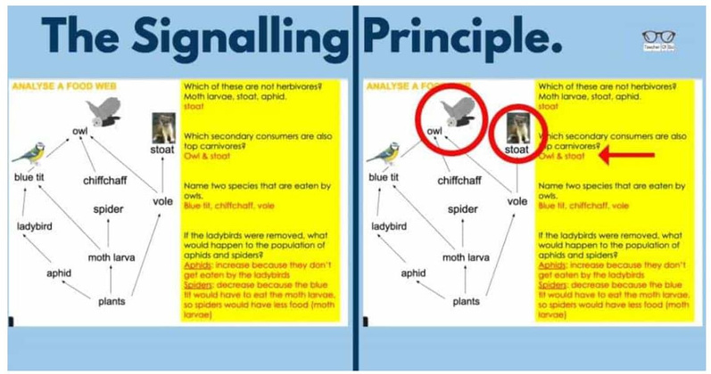
40
From Mayer’s 12 Principles of Multimedia Learning — Signaling Principle, by LaurenHays, 2021, on the Digital Learning Institute website. Retrieved from https://www.digitallearninginstitute.com/blog/mayers-principles-multimedia-learning
Signaling means to be intentional in the placement of cues (i.e., arrows,circles,highlights,etc.)
to draw a learner’s eyes to specific components of the learning materialattherelevanttimes.
This reduces cognitive load because learners do not have to expendpartoftheirmentaleffort
on hunting and identifying the relevant information or components.Thegoaloflearningisfor
learners to “create a meaningful, coherent representation or model”oftheconceptbeingtaught
rather than “just memorizing a set of isolated facts” (Schneideretal,2018,p.377).Signaling
helps learners to “distinguish between learning-relevant and learning-irrelevantinformation,”
which reduces frustration and cognitive overload (Richter et al,2016).
When working with adult learners, one of the key considerationsineducationaldesignisthe
level of prior knowledge. Schneider, et al (2018) proposed that signalingis“especiallybeneficial
for high-prior-knowledge learners” and that “low-prior-knowledgelearnersbenefit…aswell”
(Schneider, et al, 2018)
Example
When teaching new staff and volunteers about safe ways to talk about sensitive topics, 3 key Do’s and Don’ts can be highlighted by placing green checkmarks beside a the Do’s and red “X”s for the Don’ts.
Reference(s)
Richter, J., Scheiter, K., & Eitel, A. (2016). The effect of signaling depends on extraneous
cognitive load. Applied Cognitive Psychology.
https://pmc.ncbi.nlm.nih.gov/articles/PMC8354981/
© AMERICAN COLLEGE OF EDUCATION

Slide 42
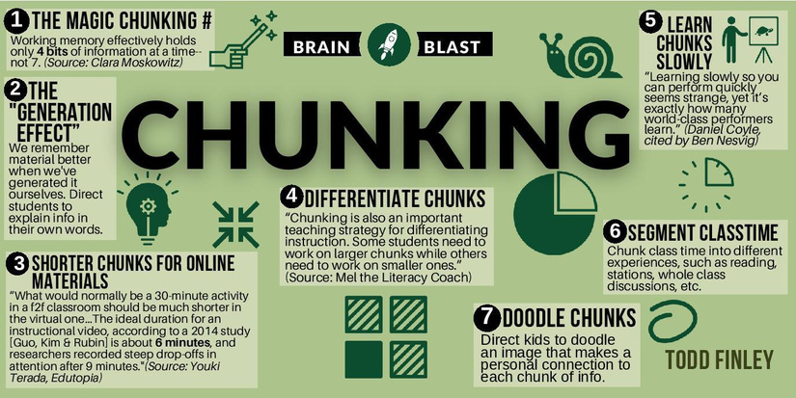
41
Schneider, B., Xie, H., van Gog, T. et al. (2018). Signaling as a cognitive guide in multimedia
learning. Schneider & colleagues. ResearchGate. https://www.researchgate.net/publication/232494695_Signaling_as_a_Cognitive_Guide_ in_Multimedia_Learning
Chunking
Figure28
The art and science of chunking.
rom The art and science of CHUNKING [Infographic], by T. Finley, 2022, August 9, X (formerly Twitter). https://x.com/finleyt/status/1557202077243379712
Chunking is the learning principle that concludes that information is more effectively learned
whenitis presented in spaller parts, or “chunks.” This principle is based on the knowledge that
“asthenumber of attributes we have to deal with increases, our capacity for accurately dealing
withthem decreases” (Georgiou, 2010, p. 616). Pappas (2023) outlines three key instructional
designstrategies for chunking:
1.Classify and prioritize content to remove irrelevant content
2.
3.
Group and divide course content into sections so learners don’t feel “lost.”
Organize the course structure to have a logical flow.
(Pappas, 2013)
Example
During volunteer onboarding training, modules can be created to cover volunteer introductory materials. Volunteer onboarding could be broken into the following 5-6-minute modules: Organization Intro, Local chapter overview, Volunteer Expectations, Volunteer Resources, and Next Steps.
© AMERICAN COLLEGE OF EDUCATION

Slide 43
42
Reference(s)
Bartsch, L. M., & Shepherdson, P. (2023). Chunking, boosting, or offloading? Using serial
position to investigate long-term memory’s enhancement of verbal working memory performance. Attention, Perception, & Psychophysics, 85, 1566–1581. https://doi.org/10.3758/s13414-022-02625-w
Finley, T. [@finleyt]. (2022, August 9). The art and science of CHUNKING | Brain Blast
[Infographic]. X. https://x.com/finleyt/status/1557202077243379712
Georgiou, I. (2010). Tools for seven and the sausage machine: Searching for conclusions in
Miller’s 1956 magical paper. Systems Research and Behavioral Science, 27(5), 461–
476. https://doi.org/10.1002/sres.1022
Pappas, C. (2013, June 3). 3 chunking strategies that every instructional designer should know
[Blog post]. eLearning Industry. https://elearningindustry.com/3-chunking-strategies-that-
every-instructional-designer-should-know
Shaffer, L. S. (1982). Hamilton’s marbles or Jevon’s beans: A demonstration of Miller’s magical
number seven. Teaching of Psychology, 9(2), 108–110.
https://doi.org/10.1207/s15328023top0902_17
Thalmann, M., Souza, A. S., & Oberauer, K. (2017). How does chunking help working memory?
Journal of Experimental Psychology: Learning, Memory, and Cognition. Retrieved from
https://www.researchgate.net/publication/324804549_How_Does_Chunking_Help_Worki
ng_Memory
Visual Cognitive Load/C-R-A-P
Figure 29
Clear and Readable Digital Presentations
© AMERICAN COLLEGE OF EDUCATION

Slide 44
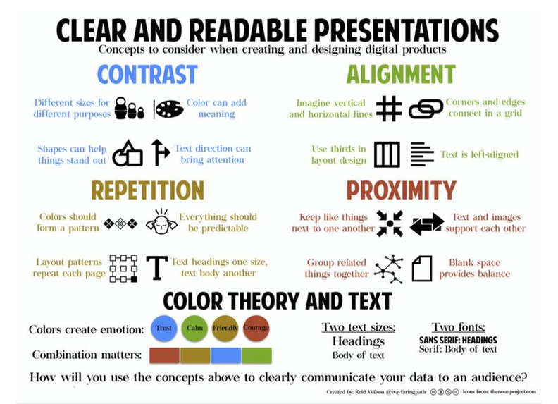
43
From Visual Design for Digital Learning: C.R.A.P. Principles – Clear and Readable Presentations [Graphic], by Digital Learning Institute, n.d., on the Digital Learning Institute website. Retrieved from https://www.digitallearninginstitute.com/blog/visual-design-for-digital- learning-c-r-a-p-principles
Visual cognitive load involves the mental load needed for learners to process and retain relevant
information from visual materials. “Split-attention” is what happens then a learner is presented
with more than one piece of visual information that is important for learning (Schroeder, 2018).
When learners experience “split-attention,” they are distracted and learn less effectively
(Schroeder, 2018). C.R.A.P. provides a framework of guidance to design visual materials with cognitive load in
mind. Visuals have an increasing presence in information presentation for learners, who “need
to attend to, search through, and evaluate this information in order to integrate it. (Linger, et al,
2009), these steps can overwhelm cognitive load if designers are not careful to provide
information that is designed in such a way to minimize cognitive load.
Figure 30
C- Contrast
© AMERICAN COLLEGE OF EDUCATION

Slide 45
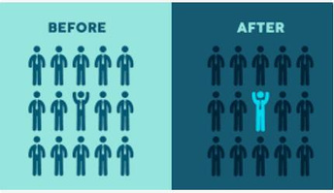
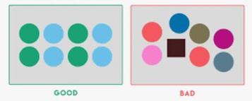
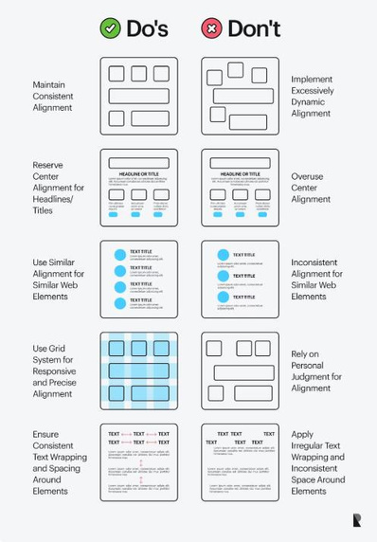
44
Figure 31 R-Repetition
Figure 32 A-Alignment
© AMERICAN COLLEGE OF EDUCATION

Slide 46
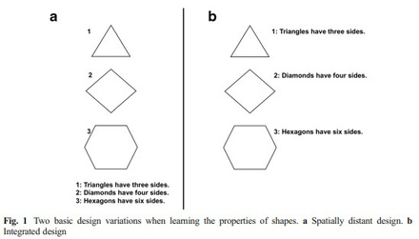
45
https://www.ramotion.com/blog/alignment-in-web-design/ Figure 34 P-Proximity
Example:
In email communication to volunteers, important information, such as dates and times, is in bold
fonts or colors. Font and formatting are consistent throughout the email. All sections of the email
are aligned to the left with consistent vertical spacing. Staff contact information is located
immediately following staff names and titles.
Reference(s)
Digital Learning Institute. (n.d.). Visual Design for Digital Learning: C.R.A.P. Principles – Clear
and Readable Presentations [Graphic]. Retrieved from https://www.digitallearninginstitute.com/blog/visual-design-for-digital-learning-c-r- a-p-principles
Klingner, J., Tversky, B., & Hanrahan, P. (2009). Effects of visual vs. verbal presentation on
cognitive load in vigilance tasks. Stanford University Technical Report.
https://research.ebsco.com/c/36ffkw/search/details/pomjembspb?limiters=FT%3AY%2C
RV%3AY&q=Effects%20of%20visual%20vs.%20verbal%20presentation%20on%20cogn
itive%20load%20in%20vigilance%20tasks
Schroeder, N. L., & Cenkci, A. T. (2018). Spatial contiguity and visual split-attention effects in
multimedia learning. Educational Psychology Review.
https://research.ebsco.com/c/36ffkw/search/details/gnupmgoahj?limiters=FT%3AY%2C
RV%3AY&q=Spatial%20contiguity%20and%20visual%20split-
attention%20effects%20in%20multimedia%20learning%2C%20Schroeder
Strategies for Student Learning
Scaffolding
Figure 35 Ascaffolding model
© AMERICAN COLLEGE OF EDUCATION

Slide 47
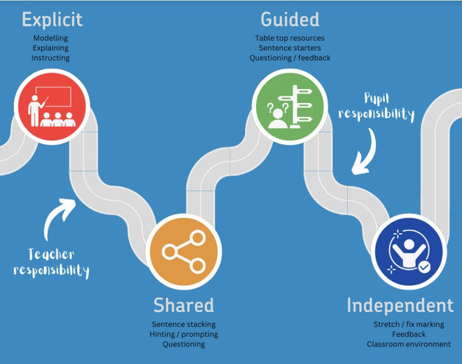
46
From Differentiation vs Scaffolding: a joint approach to adaptive teaching [Infographic], by Testbase, 2024, on the Testbase website. Retrieved from https://www.testbase.co.uk/differentiation-vs-scaffolding-a-joint-approach-to-adaptive-teaching/
Scaffolding provides intentional support for learners, enabling them to achieve learning
outcomes successfully. When learners have insufficient background knowledge, they struggle to
be successful in solving problems, even if the problems are well-designed (Ge et al., 2003).
Scaffolding ensures that learners have sufficient background knowledge and skills in place.
Kim (2011) notes some theories that have been suggested to support student learning with
technology:
1. Scaffolding hypermedia to foster self-regulated learning (Azevedo, 2005)
2. Software-based metacognitive scaffolding for online inquiry (Quintana, et al, 2005)
3. Epistemic scaffolds to guide tech-supported, explanation-driven inquiry.
Memmert, et al (2003) provided a framework for identifying issues related to student learning
success and the corresponding design requirements and principles, shown in the two figures
below. Additionally, the third figure supports their conclusion that AI scaffolding can be used to
support learning.
Figure 36
Learner requirements for problem solving.
© AMERICAN COLLEGE OF EDUCATION

Slide 48
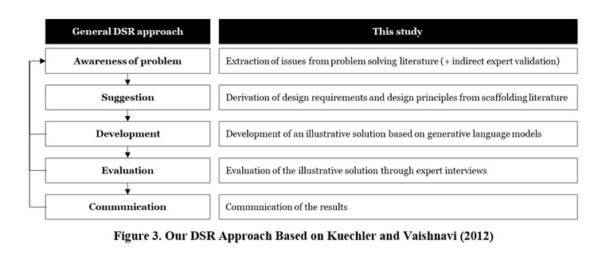
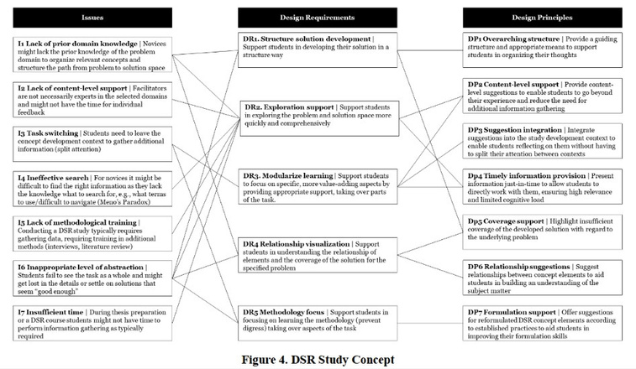
47
From Memmert, L., Tavanapour, N., & Bittner, E. (2023). Learning by doing: Educators’ perspective on an illustrative tool for AI-generated scaffolding for students in conceptualizing design science research studies. Copyright 2023 by the Journal of Information Systems Education. Figure 37
Designprinciples for learner shortcomings for problem-solving.
From Memmert, L., Tavanapour, N., & Bittner, E. (2023). Learning by doing: Educators’ perspective on an illustrative tool for AI-generated scaffolding for students in conceptualizing design science research studies. Copyright 2023 by the Journal of Information Systems Education.
© AMERICAN COLLEGE OF EDUCATION

Slide 49
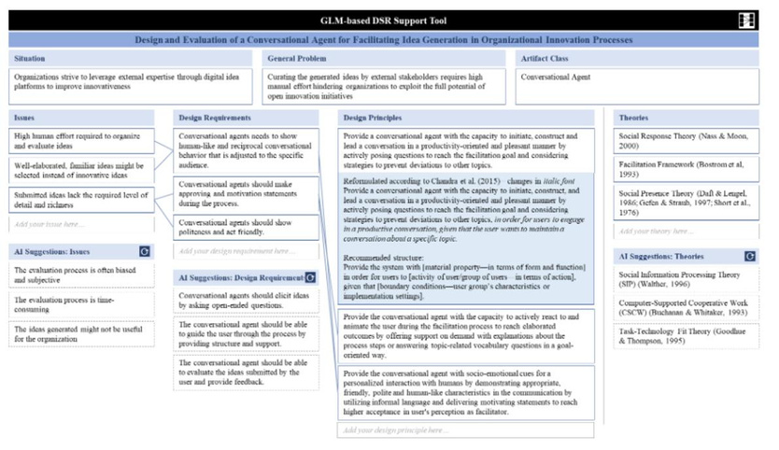
48
Figure 38
UsingAItocreate learner scaffolding.
From Memmert, L., Tavanapour, N., & Bittner, E. (2023). Learning by doing: Educators’ perspective on an illustrative tool for AI-generated scaffolding for students in conceptualizing design science research studies. Copyright 2023 by the Journal of Information Systems Education.
Example
When volunteers first begin presenting, they are invited to watch multiple presentations by seasoned presenters, provided with support to record themselves practicing, and then connected with a mentor to start presenting small sections of programming in public, gradually building up to larger portions of a presentation. This scaffolding allows volunteers to gradually increase their confidence and speaking fluidity over the course of several months.
Reference(s)
AVIANTY, A., Friantini, et al. (2023). Influence of problem-solving understanding on math
learning outcomes. Frontiers in Education. https://www.frontiersin.org/articles/10.3389/feduc.2023.1088556/full
Ge, X., & Land, S. M. (2003). Scaffolding students’ problem-solving processes in an
ill-structured task using question prompts and peer interactions.
EducationalTechnology
Research and Development, 51(1), 21–38. https://doi.org/10.1007/BF02504515
Kim, M. C., & Hannafin, M. J. (2011). Scaffolding problem solving in technology-enhanced
learning environments (TELEs): Bridging research and theory with practice.
& Education, 56(2), 403–417.
https://www.sciencedirect.com/science/article/abs/pii/S0360131510002526
Computers
© AMERICAN COLLEGE OF EDUCATION

Slide 50
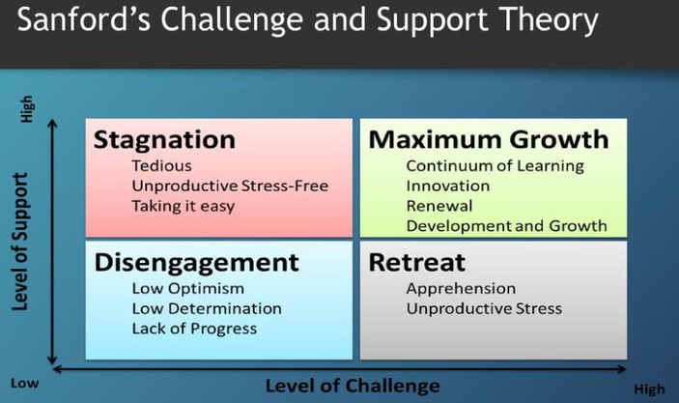
49
Memmert, L., Tavanapour, N., & Bittner, E. (2023). Learning by doing: Educators’ perspective
on an illustrative tool for AI-generated scaffolding for students in conceptualizing design science research studies. Journal of Information Systems Education, 34(3), 279–292. https://research.ebsco.com/c/36ffkw/search/details/feognmlwu5?limiters=FT%3AY%2CR V%3AY&q=Scaffolding%20problem%20solving%20in%20technology- enhanced%20learning%20environments%3A%20Bridging%20Research%20and%20the ory%20with%20practice%2C%20Kim
Dennen, V. P. (2004). Cognitive apprenticeship in educational practice: research on scaffolding,
modeling, mentoring, and coaching. NIU C.I.T.L. Guide.
https://www.niu.edu/citl/resources/guides/instructional-guide/instructional-scaffolding-to-
improve-learning.shtml
Testbase. (2024, February 19). Differentiation vs scaffolding: A joint approach to adaptive
teaching [Infographic]. Testbase. https://www.testbase.co.uk/differentiation-vs-
scaffolding-a-joint-approach-to-adaptive-teaching/
Levels of Challenge
Figure 38
Challengeand support theory for learning.
From Sanford’s Challenge and Support Theory [Diagram], in Matrix of Student Success: A 2x2 w/ Social + Academic Engagement, by Deep Thoughts Ed, 2024, July 7. Retrieved from https://deepthoughtshed.com/2024/07/07/matrix-of-student-success-a-2x2-w-social-academic- engagement/
© AMERICAN COLLEGE OF EDUCATION

Slide 51
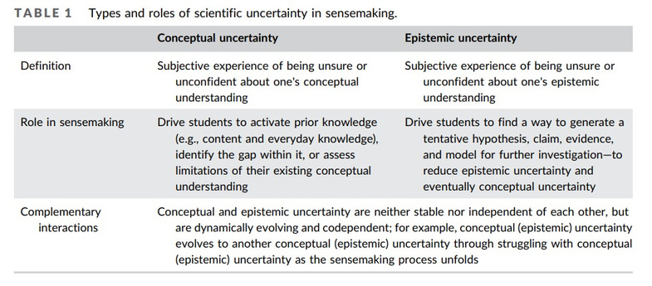
50
Levels of challenge are based on the theory that learners need to be challenged “optimally and continually, because if they are challenged too much or not enough, it can lead to loss of learning potential (Davis, 2015). Davis (2015) suggests three key components for challenging learners effectively:
1. The speed and difficulty of learning are continually adjusted
2. Instructor expectations align with student aptitudes.
3. Reduce the variation in student learning.
(Davis, 2015)
Productive struggle means enabling learners to recognize and persist through struggles for the
purpose of learning (Chen, 2024). The tables below illustrate the types of “uncertainty” that
induce productive struggling and its anticipated learning outcomes.
Figure 39
Typesandroles of learner uncertainty.
Figure 40
Sourcesoflearner uncertainty and how to use that uncertainty to design learning.
© AMERICAN COLLEGE OF EDUCATION

Slide 52
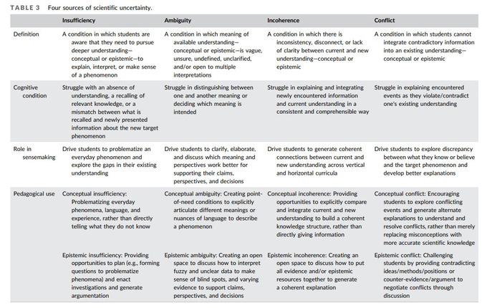
51
Example
When supporting a volunteer board through annual goal setting, provide them with a toolkit of information, statistics, previous goals, and accomplishments. Include a template for goal setting topics and then break them into groups where each member engages in constructive discussion about an area of focus that they are specifically interested in and engaged with. Then let them complete the task of setting out appropriate goals and be able to back up those choices when they present them later to the full board.
Reference(s)
Chen, Y.-C., Jordan, M., Park, J., & Starrett, E. (2024). Navigating student uncertainty for
productive struggle: Establishing the importance for and distinguishing types, sources,
and desirability of scientific uncertainties. Science Education, 108(4), 1099–1133.
https://doi.org/10.1002/sce.21864
Davis, M. H., & Hackathorn, J. (2015). Theory of sustained optimal challenge in teaching and
learning. Techne: Research in Synthesis of Knowledge, 19(1), 55–65.
https://journals.sagepub.com/doi/10.1177/1541931213601584
Tayler, J., et al. (2024). Learning in challenge-based contexts: designing optimal tasks. Learning
Environments Research. https://journals.sagepub.com/doi/10.1177/14697874241230459
Wisniewski, B., & Zwaan, R. (2024). Productive struggle: balancing challenge and support.
Journal of Educational Change. (Review, open access).
Active Learning
Figure 41
Active learning outcomes triangle.
© AMERICAN COLLEGE OF EDUCATION

Slide 53
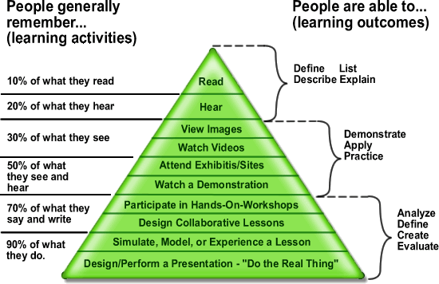
52
From Active Learning Pyramid [Graphic], in Active Learning, by UBC Wiki, n.d. Retrieved from https://wiki.ubc.ca/Course:EDCP371_951_2010/Active_learning
“Active learning engages students in the process of learning through activities and/or discussion
in class as opposed to passive listening to an expert” (Freeman, et al, 2014). Nguyen, et al
propose 8 strategies for successfully implementing active learning:
1. Explanation – Describing the benefits and purpose of the active learning component
(typically before learning begins)
a. Establish expectations
b. Explain the purpose
2. Facilitation – promoting engagement in the activity and keeping it running smoothly.
a. Learners- engage with students during the activity
b. Encourage learners – create a motivating and supportive environment.
3. Planning
a. Choose appropriate activities – in terms of time constraints, difficulty level,
engaging activity, relevant, etc.
b. Create group policies – team sizes, role assignment, responsibility delegation,
group selection, etc.
c. Align the course – intentionally connecting multiple parts of a course together
with the activity. Additionally, align the activity with grade expectations.
d. Solicit and review student feedback.
(Ngyuen, et al, 2014)
© AMERICAN COLLEGE OF EDUCATION

Slide 54
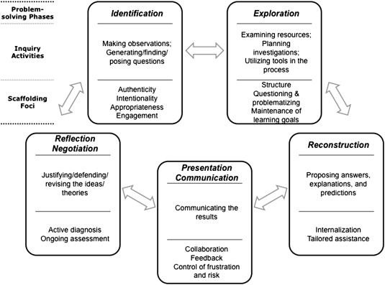
53
Example
When new volunteers are interested in getting involved with advocacy efforts, training could include opportunities to practice “telling their story,” or presenting “their ask” for others who can help guide them in tweaking or strengthening their skills in speaking about advocacy issues.
Reference(s)
Freeman, S., et al. (2014). Active learning increases student performance in STEM. PNAS,
111(23), 8410–8415. https://www.pnas.org/content/111/23/8410
Nguyen, K., Borrego, M., Finelli, C, et al (2021). Instructor strategies to support implementation
of active learning. International Journal of STEM Education.
https://stemeducationjournal.springeropen.com/articles/10.1186/s40594-021-00270-7
UBC Wiki. (n.d.). Active learning pyramid [Graphic]. In Active learning.
https://wiki.ubc.ca/Course:EDCP371_951_2010/Active_learning
Wittayakom, S., Kanjanavisutt, C., & Wongwanich Rumpagaporn, M. (2024). Online training by
active learning approaches: A systematic literature review. Higher Education Studies,
14(2), 1–15. https://eric.ed.gov/?id=EJ1413820
Xu, Y., & Qian, Z. (2025). Active learning strategies in video learning: a meta-analysis.
Computers & Education, 200, 104–118.
https://www.sciencedirect.com/science/article/abs/pii/S1747938X25000454
Problem-Solving Tasks
Figure 42
The problem-solving method.
© AMERICAN COLLEGE OF EDUCATION

Slide 55
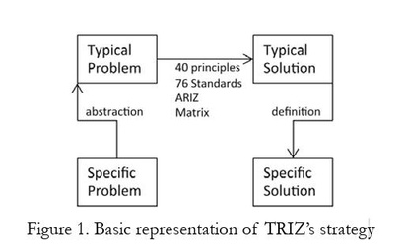
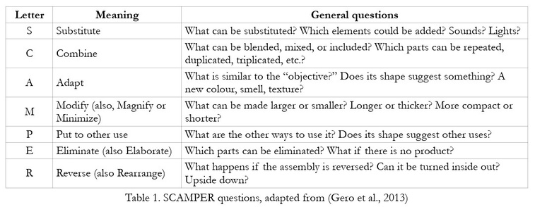
54
From Scaffolding problem solving in technology-enhanced learning environments (TELEs) [Diagram], by M. C. Kim & M. J. Hannafin, 2011, Computers & Education, 56(2), 403–417. https://www.sciencedirect.com/science/article/abs/pii/S0360131510002526. Copyright © 2011 Elsevier Ltd.
In problem-solving learning, learners are provided with methods and tools that they can apply to
solve a defined problem (Duran-Nova & Torres, 2024). Duran-Nova & Torres investigated
designs for problem-solving methods:
Figure 42
TRIZ – TheContradiction Method
Figure 43
SCAMPERMethod
Figure 44
Kj-Technique
© AMERICAN COLLEGE OF EDUCATION

Slide 56
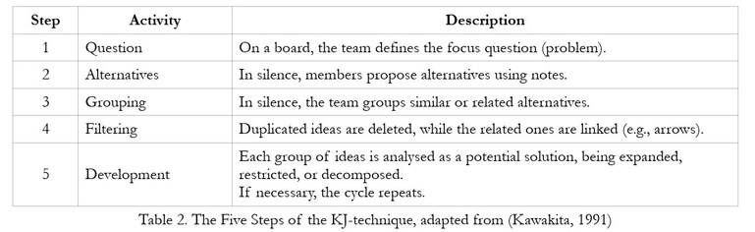
55
(Duran-Nova & Torres, 2024).
Example
If community engagement is a concern, staff and volunteers could be tasked with “problem-
solving” how to increase engagement during development opportunities. Break the group into
smaller groups and ask them to come up with solutions that will be shared and discussed with
the full group. Then, let the whole group plan with 3-5 “action items” based on the problem-
solving discussions.
Reference(s)
Brummer, L., de Boer, H., & Strijbos, J.-W. (2024). Meta-analysis of digitally delivered
instructional feedback and its effects on problem-solving performance. Educational Research Review. https://link.springer.com/article/10.1007/s10984-024-09501-4 SpringerLink
Duran-Novoa, R., & Torres, F. (2024). Unveiling the impact of design methods on problem-
solving performance in undergraduate STEM education. Journal of Technology and
Science Education, 14(1), 85–99. https://eric.ed.gov/?id=EJ1452101
Zheng, X., & Tian, Q. (2023). Effectiveness of online collaborative problem-solving method on
students' learning performance: A meta-analysis. Journal of Computer Assisted
Learning, 40(1), 326–341.
https://www.researchgate.net/publication/374414623_Effectiveness_of_online_collabora
tive_problem-solving_method_on_students_learning_performance_A_meta-analysis
© AMERICAN COLLEGE OF EDUCATION

Slide 57

56
Knowing the Learner
Module 4
Learner and Context Analysis
Dick and Carey Model
The Dick and Carey model, also known as the Systems Approach Model, represents a comprehensive and systematic framework for instructional design first introduced in 1978 in "The Systematic Design of Instruction" (Instructional Designers of Penn State, 2018). This influential model stands apart from earlier linear approaches by emphasizing the interconnections between all design elements and incorporating crucial feedback loops throughout the process.
This model's iterative nature makes it particularly effective—instructional designers can
continuously refine and modify components based on evaluation data, ensuring the entire
instructional system evolves to better meet learner needs. Rather than viewing instruction as
simply delivering content, the Dick and Carey model conceptualizes instruction as a complete
system aimed at helping learners achieve specific outcomes (Dick & Carey, 2015).
Steps
Definition/Description
1. Identify Instructional Goals
Determine what learners should be able to do after completing
instruction by analyzing needs, examining existing goals, or conducting needs assessments.
2. Conduct Instructional Break down the instructional goal into specific component skills and
Analysis 3. Analyze Learners and Contexts
4. Write Performance
Objectives
knowledge required for successful performance.
Identify characteristics of target learners, including prior knowledge,
skills, attitudes, and the learning environment where skills will be used.
Specify exactly what learners can do, under what conditions, and to
what standard after instruction.
5. Develop Assessment Create assessments directly tied to performance objectives that
Instruments 6. Develop Instructional Strategy
7. Develop and Select
Instructional Materials
measure learner achievement of each objective.
Plan the specific instructional activities, including pre-instructional
activities, content presentation, learner participation, assessment, and follow-through.
Create or select instructional materials based on the instructional
strategy, including instructor guides, student materials, and media.
8. Design and Conduct Test instructional materials with representative learners to identify
Formative Evaluation 9. Revise Instruction
areas for improvement before full implementation.
Use data from formative evaluation to improve the effectiveness of
instruction through targeted revisions.
© AMERICAN COLLEGE OF EDUCATION

Slide 58
57
This comprehensive understanding of learners, including their academic motivation, learning preferences, and contextual needs, enables instructional designers to create targeted, effective learning experiences that align with performance objectives while accommodating the specific characteristics of the learner population.
Example
As an instructional designer at a mid-sized university, I was tasked with developing a new online graduate course in educational leadership. Rather than diving straight into content creation, I employed the Dick and Carey model to ensure a systematic approach.
I met with the subject matter expert to identify the core instructional goal: preparing students to
develop data-driven school improvement plans. Through careful analysis, we determined the
essential skills students would need and examined the unique characteristics of our working
professional student population.
With established, clear performance objectives, I developed authentic assessments that
measure students' ability to analyze school data and create implementation plans. These
assessments directly informed my instructional strategy, which balanced theoretical foundations
with practical applications relevant to the students' professional contexts.
As I developed the course materials, I maintained focus on the interconnected nature of the
Dick and Carey model. When initial testing with a small student group revealed confusion
around data analysis procedures, I quickly revised those specific modules while ensuring the
changes aligned with the established objectives and assessments.
This systematic, iterative approach allowed me to create a cohesive learning experience that
addressed the specific needs of the graduate students while maintaining rigorous academic
standards—demonstrating the practical value of the Dick and Carey model in higher education
instructional design.
Reference(s)
Dick, W., & Carey, L. (2015).
The systematic design of instruction
(8th ed.). Pearson.
Instructional Designers of Penn State. (2018). Dick and Carey model of design.
Pressbooks. https://psu.pb.unizin.org/idhandbook/chapter/dick-carey/
Sociocultural Factors
Sociocultural Theory
Figure 45
Lev Vygotsky’s Sociocultural Theory
© AMERICAN COLLEGE OF EDUCATION

Slide 59
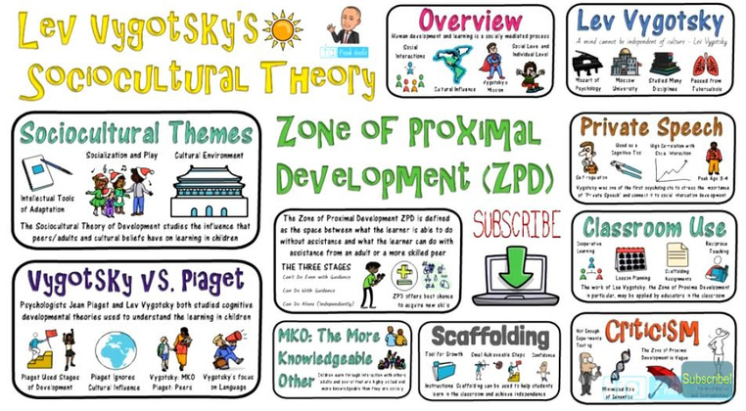
58
Infographic summarizing Lev Vygotsky’s Sociocultural Theory, including key concepts such as the Zone of Proximal Development, scaffolding, private speech, and comparisons with Piaget. Adapted from Lev Vygotsky’s Sociocultural Theory [Video], by Frank Adam, 2021, YouTube. https://www.youtube.com/watch?v=_fWm7cF8-WM
Sociocultural theory proposed that all learning happens through socialization and exposure to
the culture (John-Steiner, et al, 1996). Eun (2016) highlights the four major domains of
Vygotsky’s theory:
1. Sociocultural domain – learning happens through social interactions.
2. Ontogenetic domain – society adopts practices and tools to support socialization.
3. Phylogenetic domain – human cognitive and social patterns evolve.
4. Microgenetic domain – language development occurs through socialization, over time.
Vygotsky’s Zone of Proximal Development suggests that learners grow in knowledge and skill
as they interact with a “more knowledgeable other,” highlighting the important role that
educators play in learning. “Collaboration between teacher and learner bridges the gap between
the individual and society, facilitating the development of a creative product—new knowledge”
(Rigopouli, et al, 2025). When considering instructional design implications, it is also crucial to
remember that “prioritizing student thinking leads to better student learning” (Jeong et al, 2022).
Examples
New public presenters, whether staff or volunteers, likely have a wide range of experience in public speaking, audience engagement, program facilitation, content knowledge, etc. According to the sociocultural learning theory, new presenters can learn how to be effective presenters by working together in peer learning groups. This could include practicing presentation delivery or
© AMERICAN COLLEGE OF EDUCATION

Slide 60
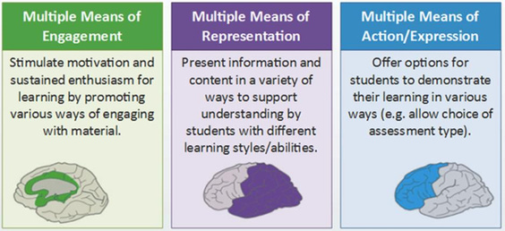
59
role-playing audience questions and responses. Others in the peer group can offer feedback based on their own experience and prior knowledge.
Additionally, applying the Zone of Proximal Development and scaffolding might look like pairing
new presenters with a presenter mentor who will work with the new presenter to co-present
portions of the presentation, in a growing amount, until they are ready to present on their own. A
mentorship scenario also capitalizes on the “More Knowledgeable Other (MKO)” as the
seasoned presenter can share knowledge with the new presenter as they work together to
provide programming.
Reference(s)
Eun, H., Shabani, K., & Ewing, B. (2016). Applications of Vygotsky’s sociocultural approach for
teachers’ professional development. Cogent Education, 3(1), Article 1252176. https://research.ebsco.com/c/36ffkw/viewer/html/giqu5sh4bb
John-Steiner, V., & Mahn, H. (1996). Sociocultural approaches to learning and development: A
Vygotskian framework. Educational Psychologist, 31(3–4), 191–206. chrome-
extension://efaidnbmnnnibpcajpcglclefindmkaj/https://www.tlu.ee/~kpata/haridustehnoloo
giaTLU/sociocultural.pdf
Jeong, S., Clyburn, J., Bhatia, N. S., McCourt, J., & Lemons, P. P. (2022). Student thinking in
the professional development of college biology instructors: An analysis through the lens
of sociocultural theory. CBE—Life Sciences Education, 21(2), ar30.
https://doi.org/10.1187/cbe.21-01-0003
Rigopouli, K., Kotsifakos, D., & Psaromiligkos, Y. (2025). Vygotsky’s creativity options and ideas
in 21st-century technology-enhanced learning design. Education Sciences, 15(2), 257.
https://doi.org/10.3390/educsci15020257
Universal Design for Learning
Figure 45
The three core
© AMERICAN COLLEGE OF EDUCATION

Slide 61
60
Visual representation of Universal Design for Learning (UDL) principles emphasizing engagement, representation, and action/expression. Adapted from Thoughts on UDL, by J. D. Hunt, 2019, Home.blog. https://jdh33431.home.blog/2019/06/22/thoughts-on-udl/
UDL is a framework for designing learning opportunities that acknowledges and supports the
diversity of learners and ensures accessibility for all (Barteaux, 2014). Designing instruction for
diverse learners means including multiple options, which Booth et al. (2018) outlined with a
variety of research-based applicable examples:
1. Engagement – the “why.”
a. Provide time for learners to practice or apply learning.
b. Ensure assignments or tasks support the learning objectives.
c. Use (accessible) technology to “enhance” learning.
d. Use collaborative learning.
e. Include “real-world” examples and experiences.
f. Provide multiple content sources.
g. Provide examples or modeling.
h. Share clear expectations (i.e. syllabus, overview, examples, and rubrics).
i.
j.
Provide notes and summaries (before, during, and after learning).
Include a variety of activity formats.
k. Respect learner diversity.
l.
Use scaffolding.
m. Assess for engagement.
2. Representation – the “what”
a. Design outcomes that support various learner preferences.
b. Utilize cues for key information.
c. Include transcripts of audio/visual materials.
d. Include “real-world” examples and experiences.
e. Allow choices for learning outcome format.
f. Provide prompt feedback.
g. Share clear expectations (i.e. overviews, examples, and rubrics).
h. Provide learning materials in multiple formats.
i.
j.
Ensure simple and accessible navigation and technology.
Use concept mapping tools, organizers, or knowledge objects,
k. Use engaging platforms (i.e. social media).
3. Action and expression – the “how.”
a. Provide accessible technology choices.
b. Provide clear expectations (i.e. examples and rubric).
c. Provide choices and flexible options for skill demonstration.
d. Provide prompt feedback.
e. Provide opportunities to practice with support.
f. Provide assessments with diversity in mind.
g. Provide concept mapping tools or organizers.
(Booth, et al., 2018)
© AMERICAN COLLEGE OF EDUCATION

Slide 62
61
Examples
Multiple means of engagement – Provide real-life scenarios to illustrate the importance of a topic and learning goal. Have volunteers pair up or form small groups to discuss how to apply their learning to the volunteer area that interests them the most.
Multiple means of representation – Provide new staff and volunteers with a well-organized
handbook that covers important topics. Additionally, provide a series of short videos with
graphics or images and narration that review each of the manual topics. Multiple means of action and expression allow new volunteers or staff to engage in reflective
journaling, participate in a “role-play review,” or create a way to share in their volunteer
collaborative community platform.
Reference(s)
Barteaux, S. (2014). Universal Design for Learning. BU Journal of Graduate Studies in
Education, 6(2), 50–52. Retrieved from https://files.eric.ed.gov/fulltext/EJ1230738.pdf
Boothe, K. A., Lohmann, M. J., Donnell, K. A., & Dean Hall, D. (2018). Applying the principles of
Universal Design for Learning (UDL) in the college classroom. Journal of Special Education
Apprenticeship, 7(3). https://doi.org/10.58729/2167-3454.1076 Craig, S. L., Smith, S. J., & Frey, B. B. (2019). Professional development with Universal Design
for Learning: Supporting teachers as learners to increase the implementation of UDL.
Professional Development in Education, 46(1), 22–37.
https://doi.org/10.1080/19415257.2019.1685563
Rusconi, L., & Squillaci, M. (2023). Effects of a Universal Design for Learning (UDL) training
course on the development of teachers’ competences: A systematic review. Education
Sciences, 13(5), 466. https://doi.org/10.3390/educsci13050466
© AMERICAN COLLEGE OF EDUCATION

